Slide 1
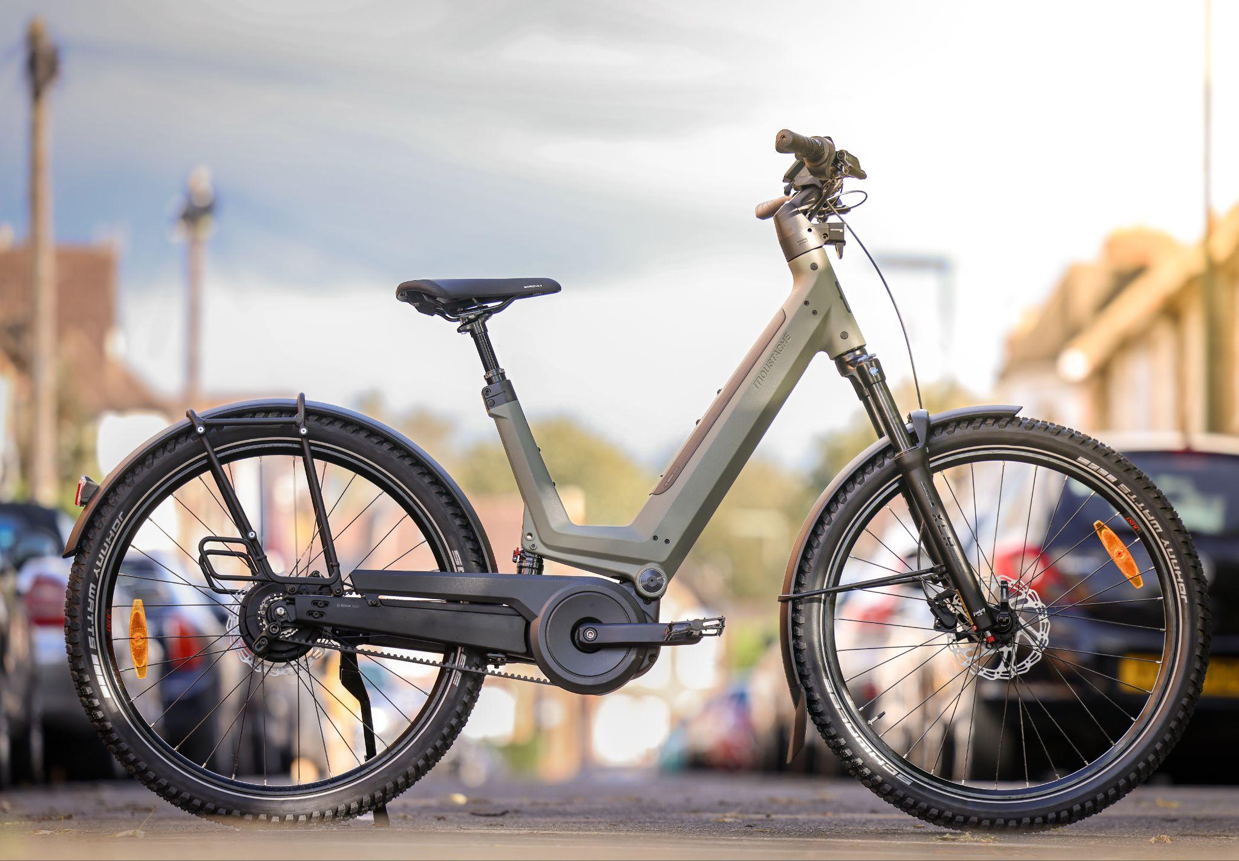



MOUSTACHE BUYERS
GUIDE 2024
SMILING MACHINES

Slide 2
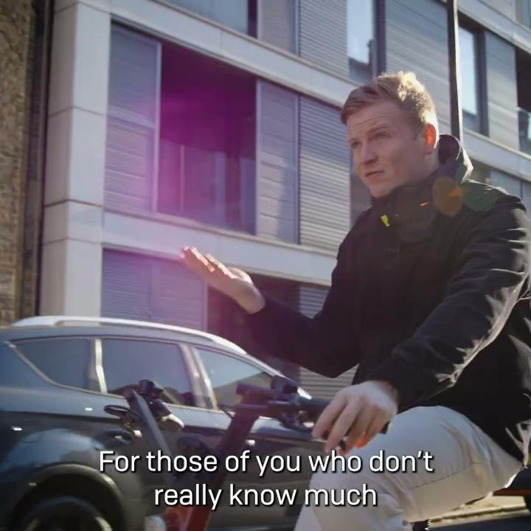


WHY BUY MOUSTACHE?
Watch Henry talk about Moustache
An eBike only brand - yes, they only produce electric bikes!
13 years experience of producing electric bikes
Pioneers and innovators for the best in eBike technology
Exceptional build quality with over 70 different models
Sustainable - they offer a real solution to more traditional methods of transport that are helping save our planet.
Did you know the average time it takes to build a Moustache is double that of a normal electric bike? It’s not rushed, the process is hand-made, with no shortcuts.
Did you know that Moustache were the first ever brand that Fully Charged stocked, 10 years ago? That’s how much we love them!

Slide 3
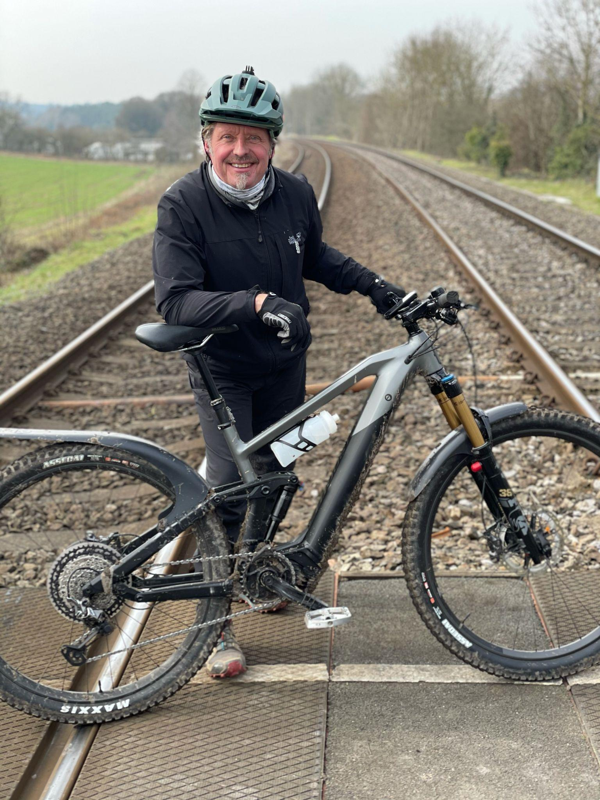
“As a man who’s been on adventures all around the world on motorbikes, I was first reluctant to get into eBikes. However, following on from yet another injury I encountered on a bike, I thought I’d finally give eBikes a whirl! I tried various types of products, but for me Moustache stood out. They have such a wide selection of eMTB models dependent on what you need them for. I have a Trail, for strictly downhilling and eMTB riding, and a Samedi 27 Weekend which has DualBattery for those proper excursions! The team couldn’t have been more helpful with my decision at Fully Charged… and I’ve been able to go out and do some proper trails with Ben around the Surrey Hills! ”
Charley Boorman
RIDES A MOUSTACHE SAMEDI TRAIL 10 &
MOUSTACHE SAMEDI 27 WEEKEND FS DUAL

Slide 4
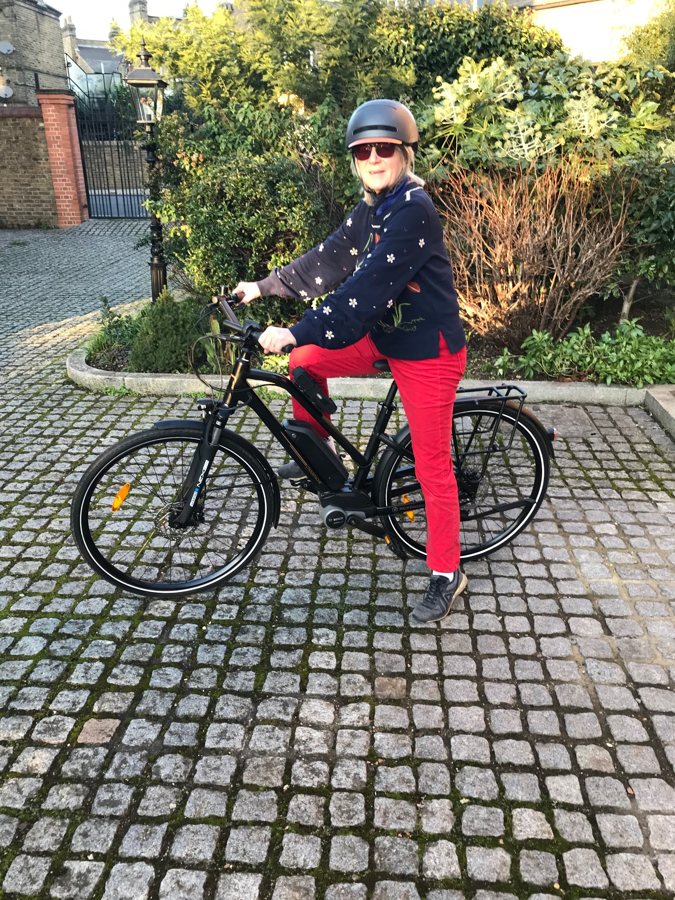
“I wanted a bike that had an upright geometry and felt comfortable to ride. I also wanted it to
be aesthetically pleasing and look like a classic eBike. The team showed me the Moustache Samedi 28.1. I simply love it! The fact I can travel up to 70 miles on a single charge, and in a comfortable position, has managed to keep me up with the girls on our days out! I now actively make time to go out for fun during the week and I go everywhere on it. Everybody at Fully Charged couldn’t have been more helpful. They gave sound and good advice. I have actually since referred three friends to Fully Charged who have bought exactly the same bike!”
Nicola Brooksbank
RIDES A MOUSTACHE SAMEDI 28.1

Slide 5
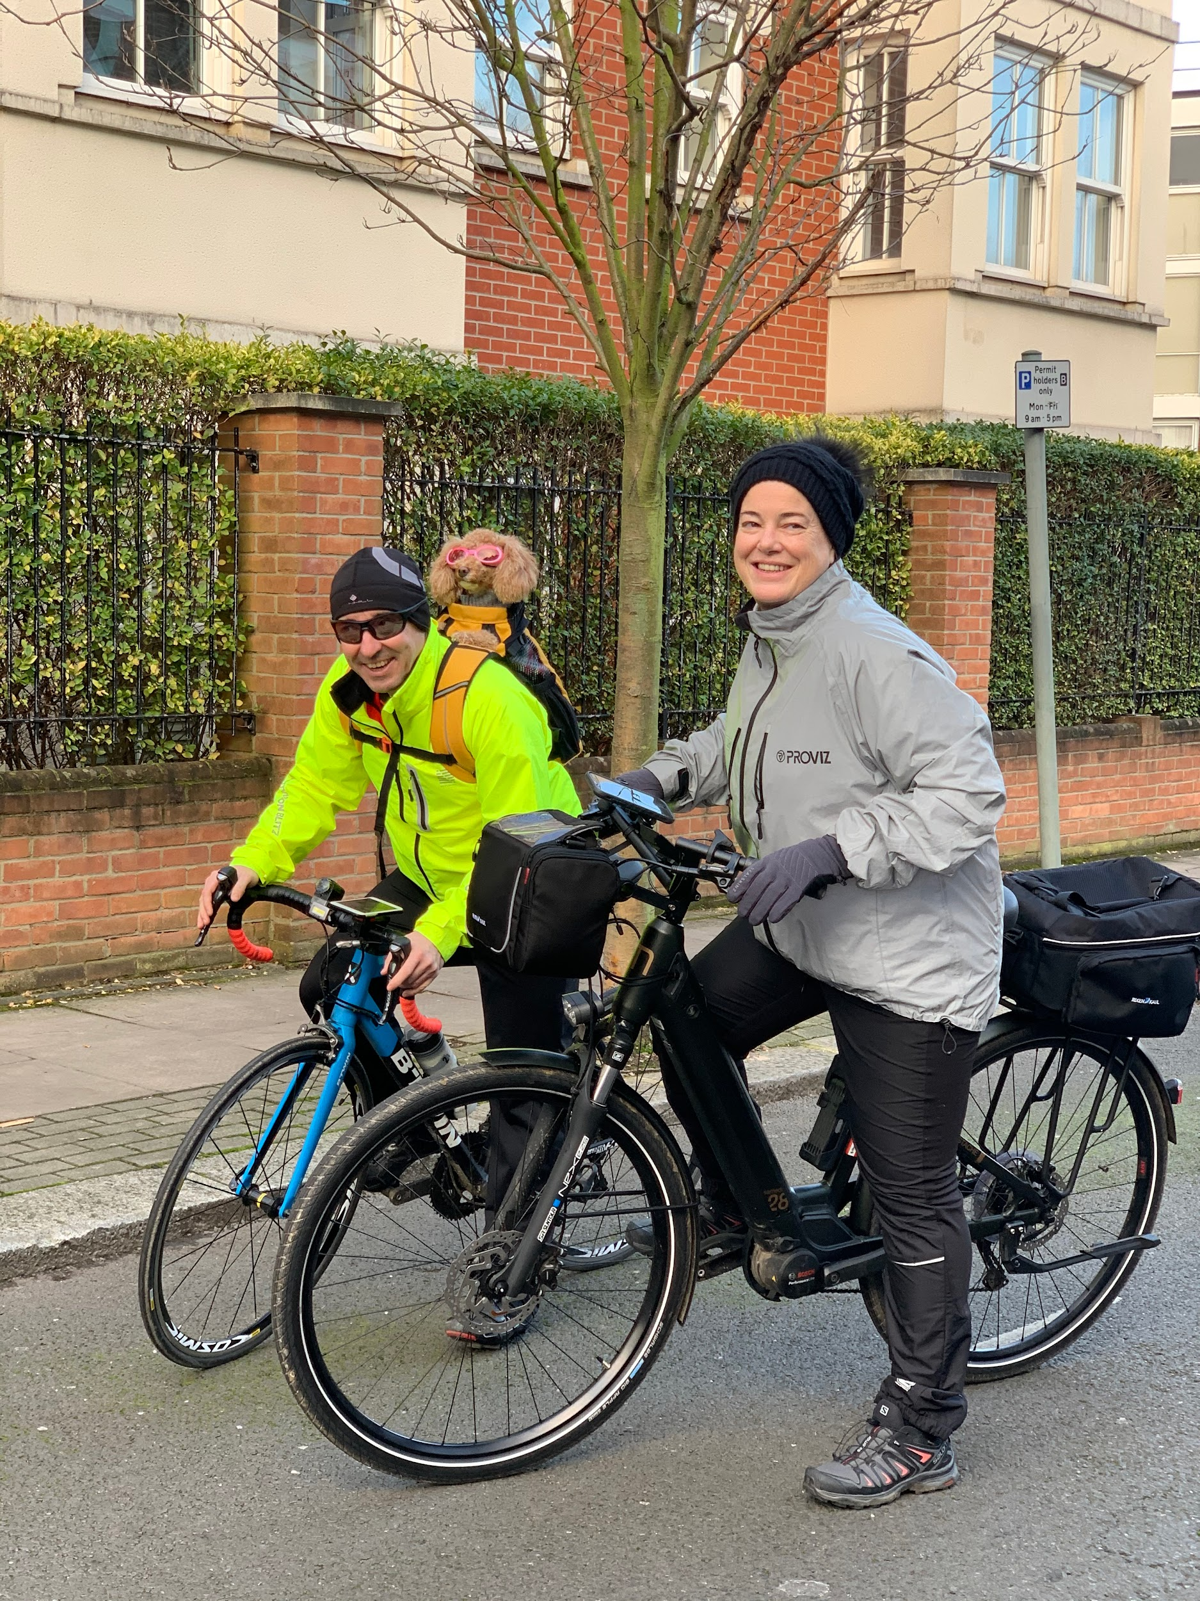
“I chose Fully Charged as I suspected from its website and reviews that it would be the best place in London (if not the UK) to offer a good breadth of brands. As an independent offering multiple brands, I also thought it would be a good place to seek expert advice as it wouldn’t lean towards any bias. The Youtube reviews with Moustache also gave the company credibility. The impact the Moustache Samedi 28.7 has had on my life has been undeniably large. I do not miss having my motorcycle at all! It enables me to keep up with my husband on his state-of-the-art road bike during the weekends, too. Fully Charged were incredibly knowledgeable and patient with me. They were responsive to my queries and informative in answering questions.”
Emma Lucas
RIDES A MOUSTACHE SAMEDI 28.7 Open

Slide 6
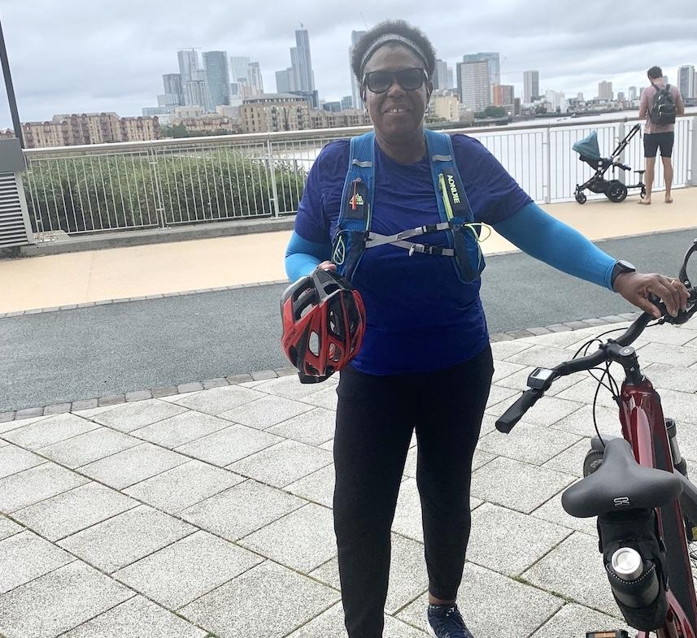
“Ben talked me through his love for the Friday FS. I just love everything about it. I love the matte burgundy finish and the sporty geometry. I now feel like I have less anxiety when going on long routes. The impact both bikes have had has been undeniable. My husband and I can now go out together, which we didn’t do before, and it’s definitely strengthened our relationship. I was drawn to Fully Charged by its ethos. From the outset they seemed dedicated and when speaking to the team I saw just how meticulous and passionate they were about their business and the products they stocked. Ben lives these bikes, and actually rode the Friday FS that I ended up buying, which showed its value to me.”
Sophia Skyers
RIDES A MOUSTACHE XROAD 2

Slide 7
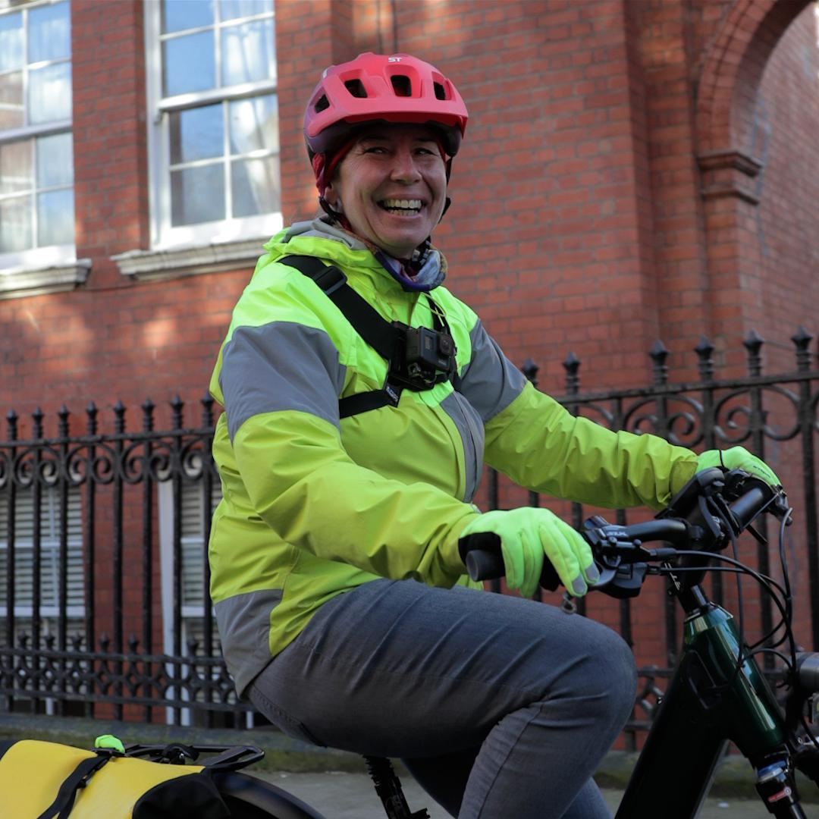
“The Xroad 5 has genuinely changed my life. Being back on a bicycle feels liberating, and being able to keep up with my friends has given me the necessary confidence and sense of freedom I’ve wanted over the past twelve months; it’s extended my boundaries. Fully Charged have always listened to my needs and matched them as opposed to selling me what they wanted to or had in stock. The aftercare has been fantastic, with the team in the service centre always being on hand should I need a new part or have a question relating to an accessory.”
Sarah Allen
RIDES A MOUSTACHE SAMEDI 27 XROAD 5 OPEN

Slide 8
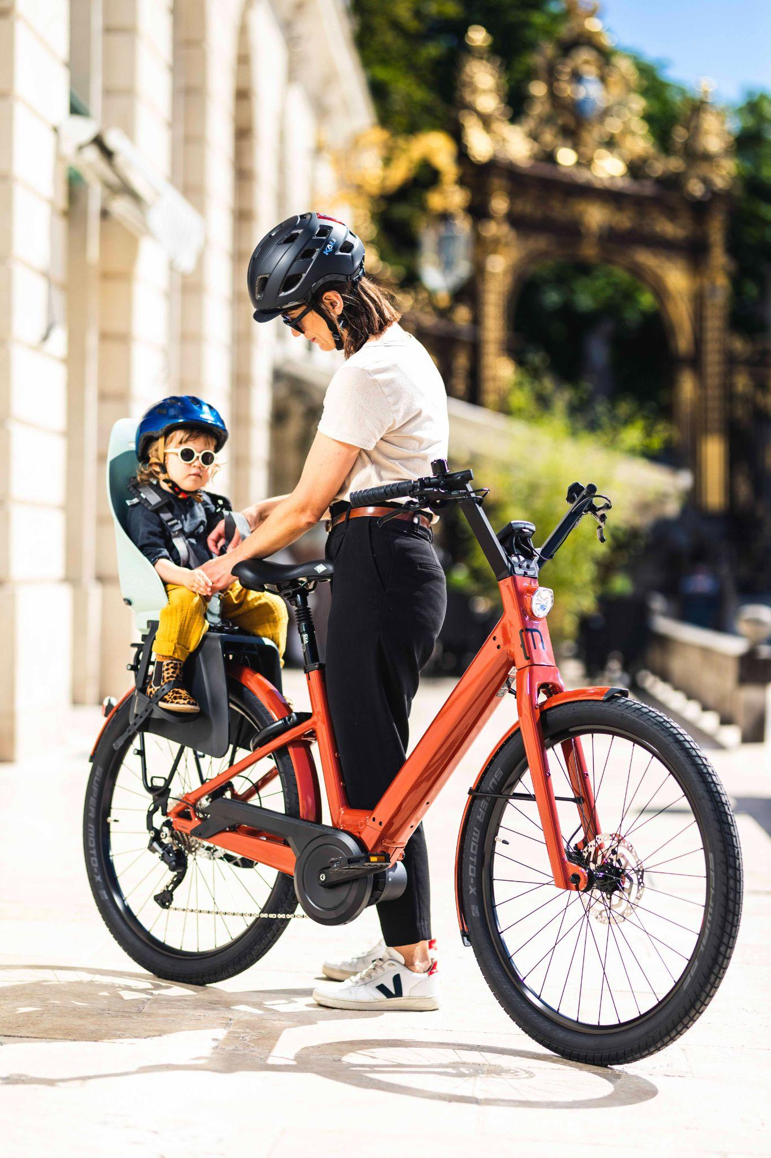
“I am a 50 year old cycling newbie who was intimidated by cycling in London. I wanted an easy, step-through, raised handlebar bike that was bullet proof and made me feel comfortable and safe in urban environments. In the summer the race was on to get a bike and my neighbour recommended Fully Charged. They very kindly let me try the bike over the weekend so I could assess if I could do my journey to work without problems. I have surprisingly enjoyed my riding experience to and from work and now feel safe when on the roads.”
Need emma simpson image please!
Emma Simpson
RIDES A MOUSTACHE LUNDI 27.1

Slide 9
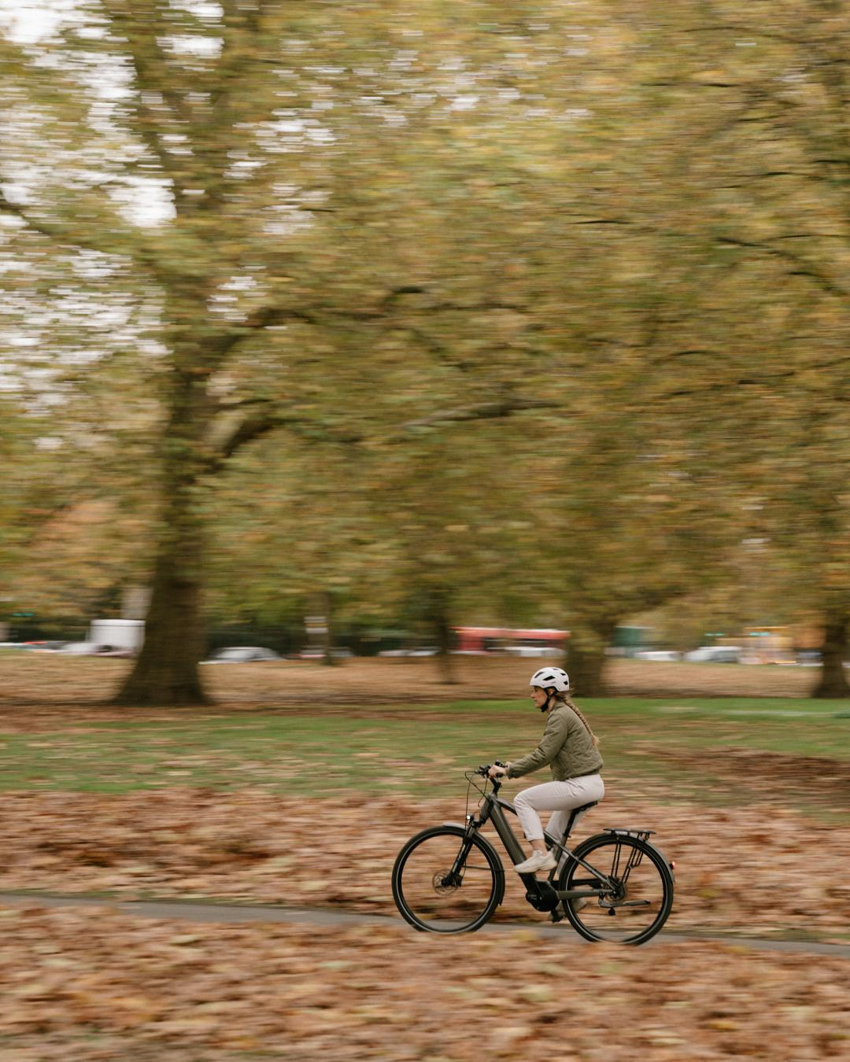

WHY NOT TO BUY A MOUSTACHE?
Moustache bikes are not for this type of person:
X
I don’t like quality, I prefer cheaply made products
X
I am happy with the second best
X
I don’t really like cycling, I just want to get from A to B
X
I’m happy on my couch

Slide 10
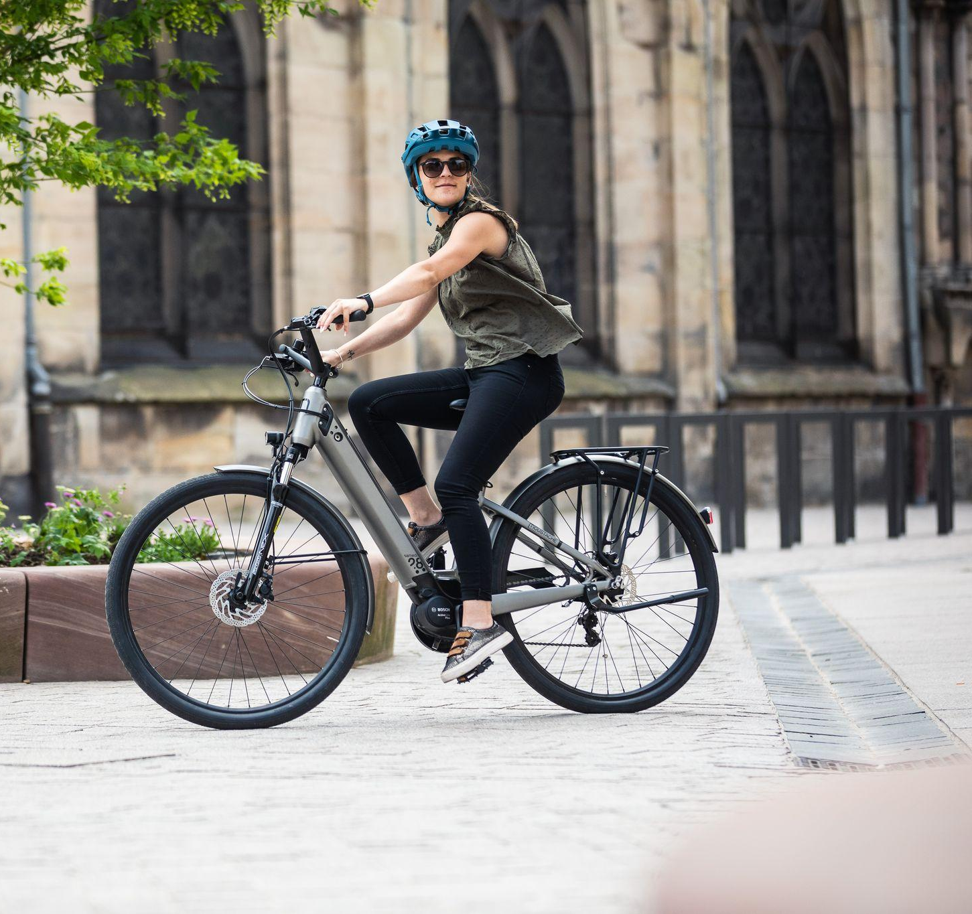
In all seriousness, there aren’t many reasons as to why you shouldn’t buy a Moustache, but possibly our biggest question is surrounding how people haven’t heard of them in comparison to other more recognised bike manufacturers, like Trek, Giant, Specialised and Cannondale…
As an eBike only manufacturer, and a complete specialist, Moustache is seen as one of the pioneers in this space. With only 100 employees that operate out of their factory in Vosges, France, Moustache’s primary focus is on their product.
They do not have the marketing arm that other far more established brands have, and so their dealers, most notably us, are left to spread the word as to how great this brand truly is!

Slide 11
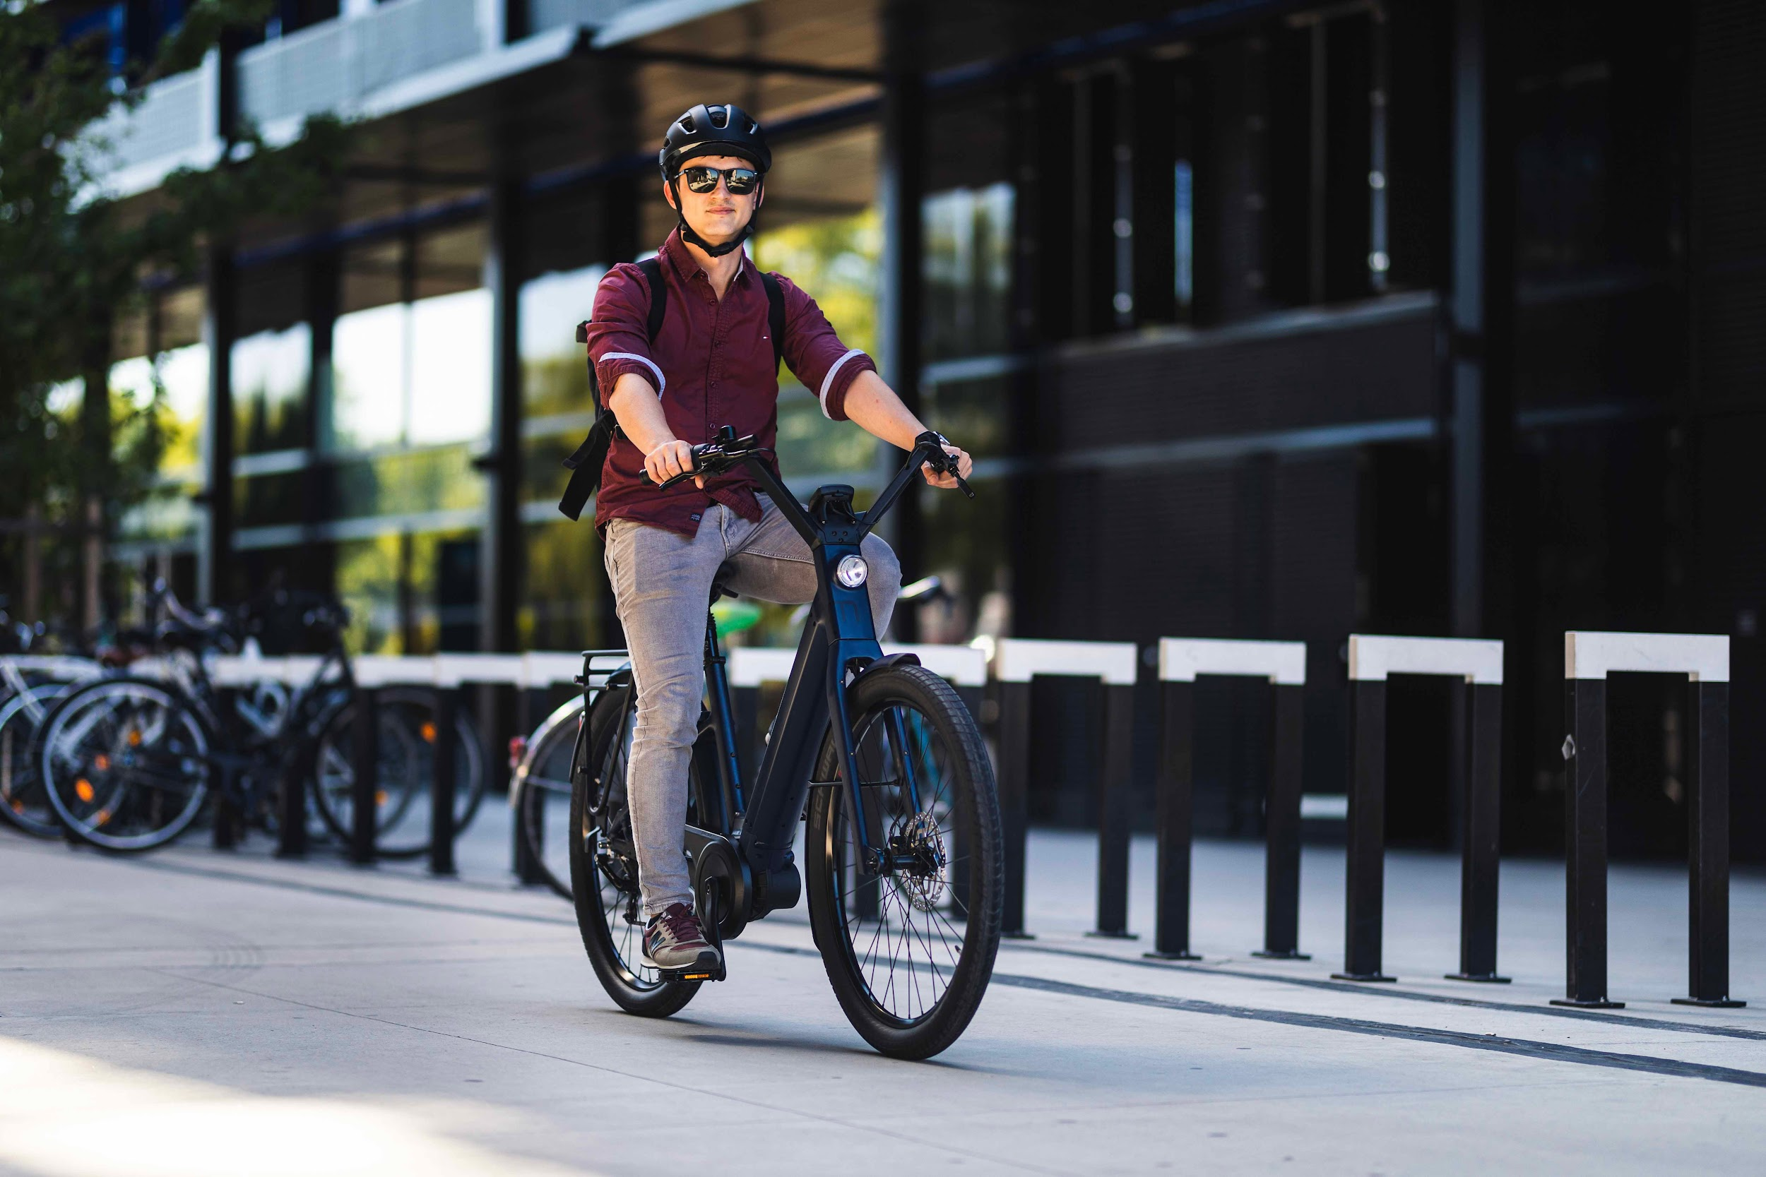
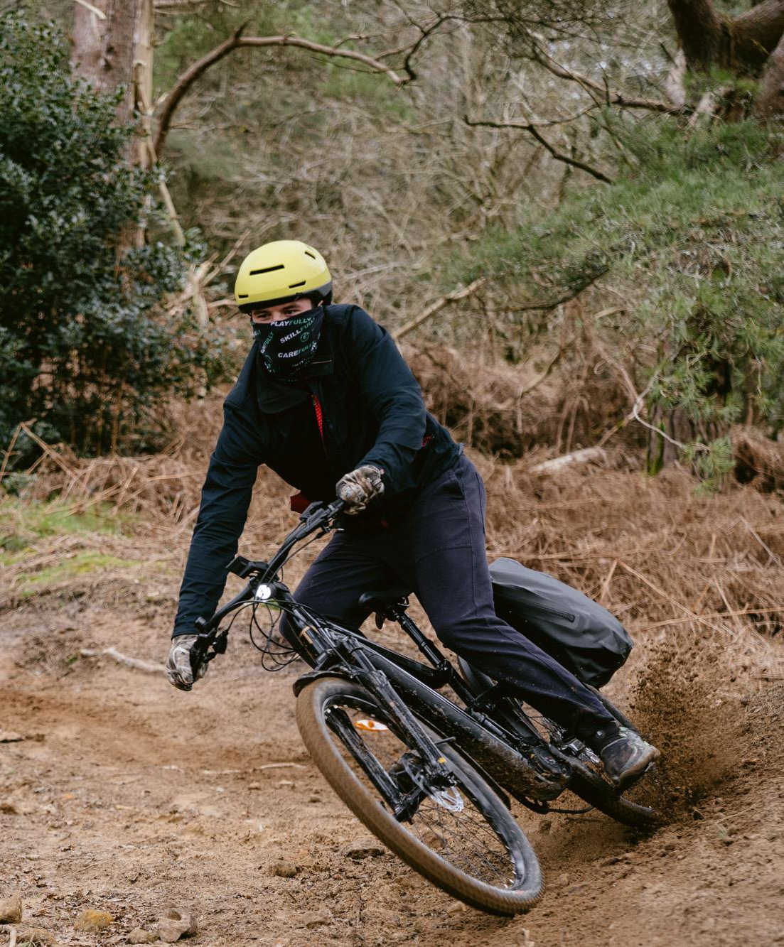
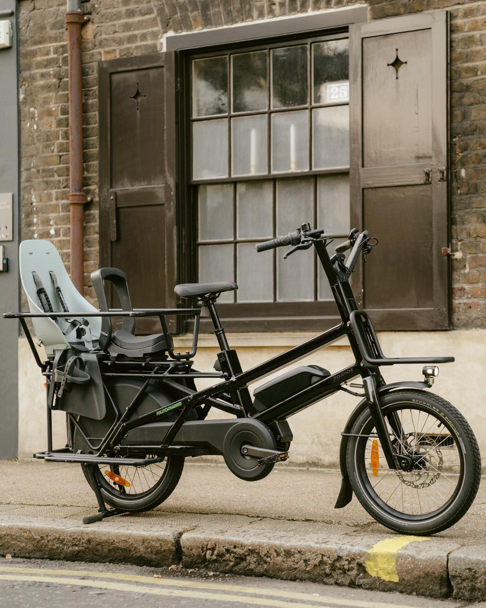
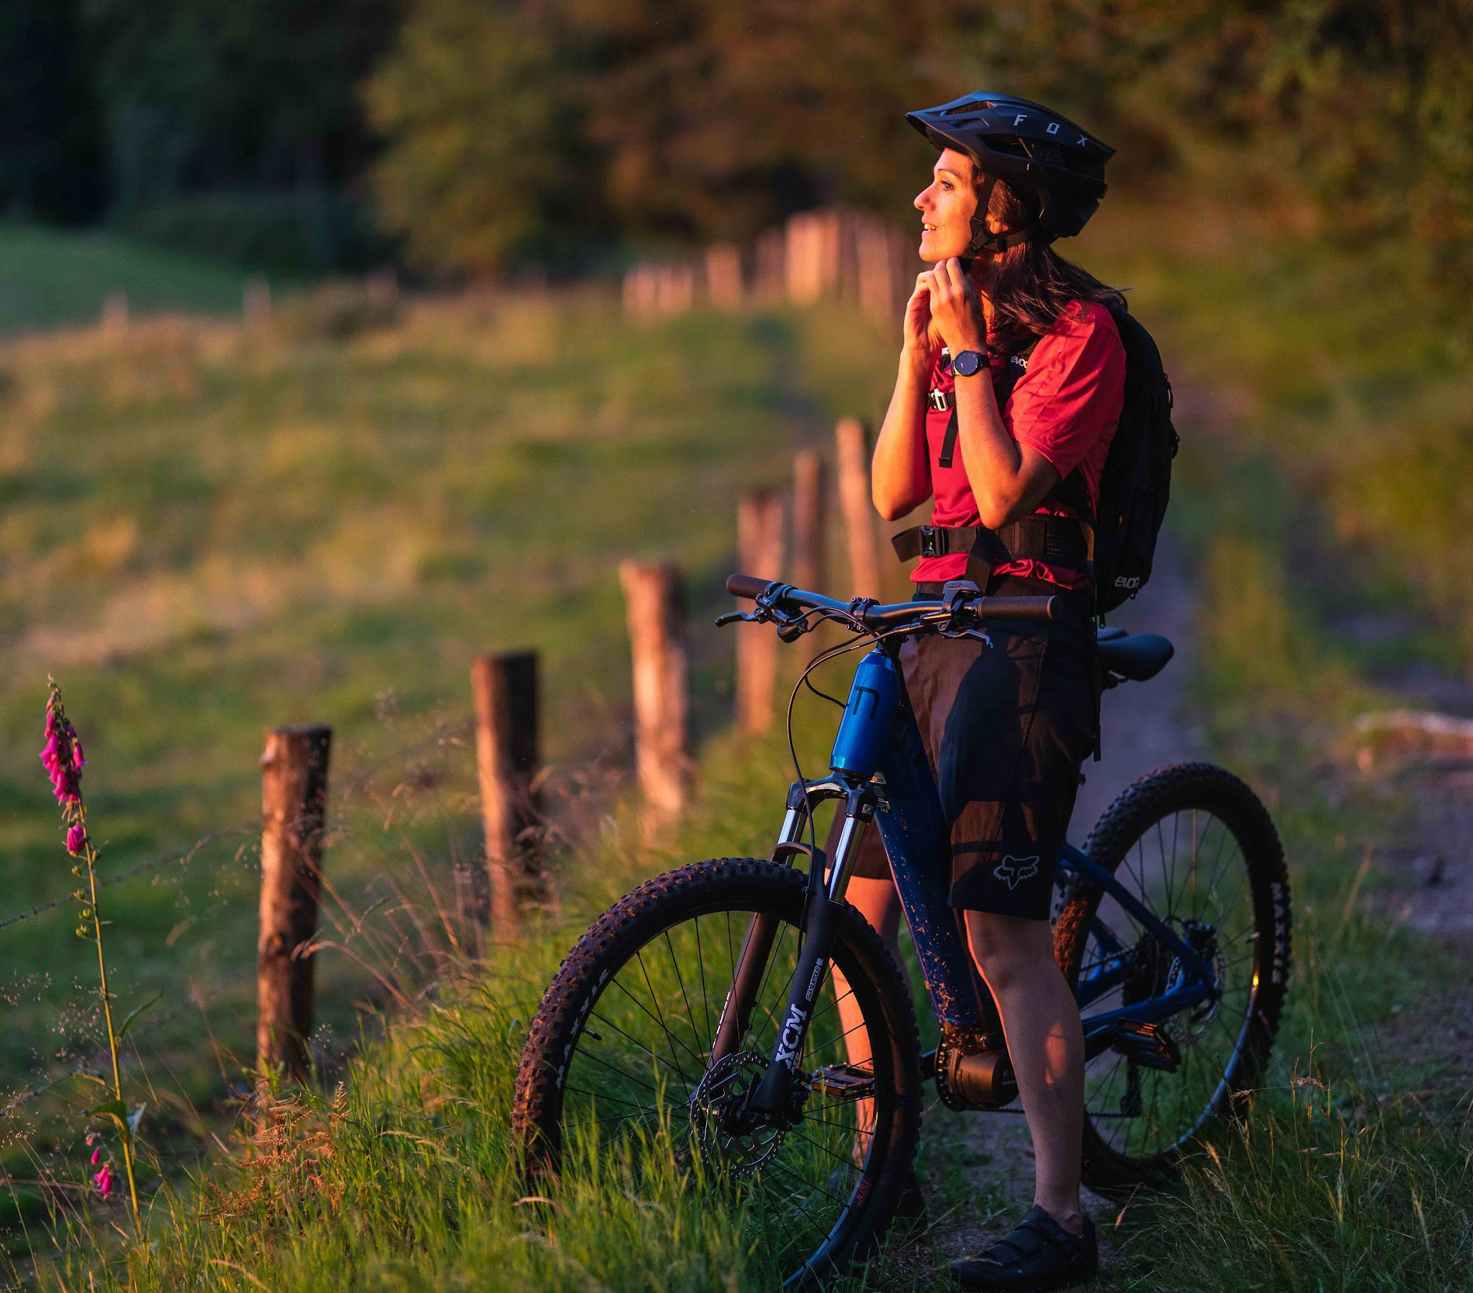
WHAT SHOULD I LOOK FOR WHEN BUYING A MOUSTACHE?
As the UK’s largest dealer of Moustache, we are proud to have a wide variety of in-stock bikes, available across the whole of the Moustache family.

Slide 12



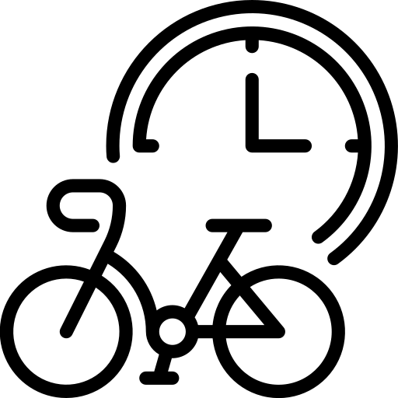


OUR SIX
SIMPLE STEPS
TO GET YOU AN
A-LIST eBIKE
1. READ OUR
BUYERS GUIDE
2. BOOK A CONSULTATION WITH ONE OF OUR TEAM
3. BOOK A STORE OR HOME TEST-RIDE
Have a flick through of this buying guide to understand a bit more about these fantastic bikes!
We have dedicated Moustache specialists at your request to speak on the phone or to buy online.
Come to any of our available stores to test-ride your favourite option, or we can come to you!
4. 3 DAYS - 6 WEEK
WAIT
5. YOUR MOUSTACHE AWAITS YOU!
6. ENJOY THE RIDE OF
YOUR LIFE
We carry over 250 Moustache bikes in stock, so either you can collect your bike within 3 days or it takes up to 6 weeks to arrive from the factory.
We either deliver the bike to you (with the option of a bespoke home handover) or you can come to the store to collect your fantastic new electric bike.
Turn on the power switch, put those feet on the pedals, and go from A to Beyond!

Slide 13
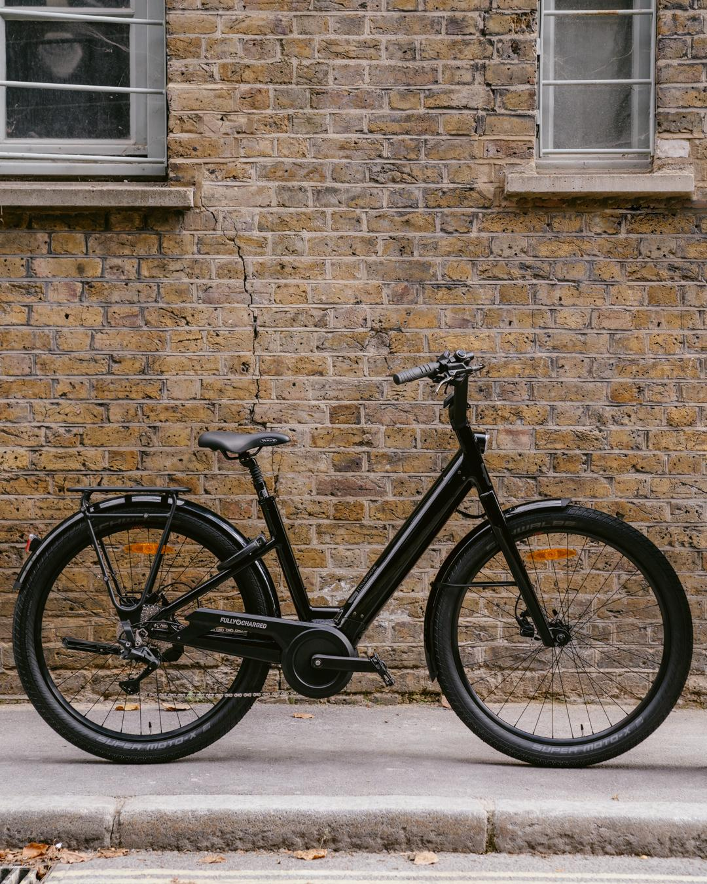

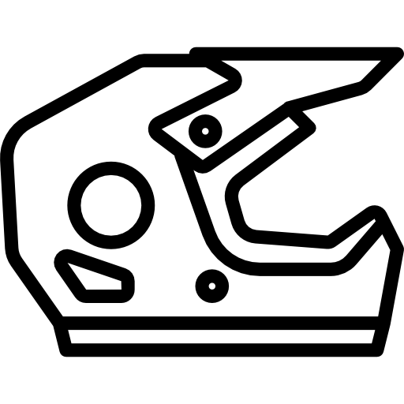

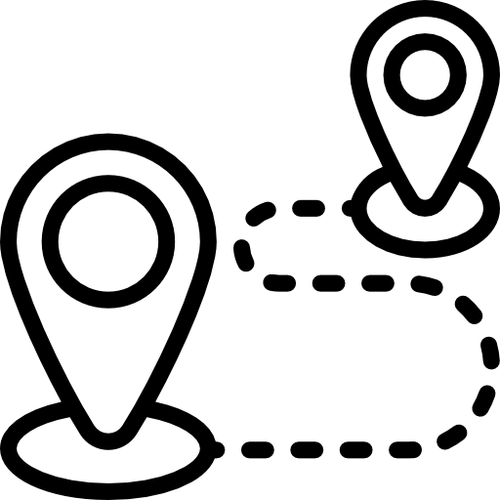



NOW TO THE FUN BIT!
The key question you have to ask yourself is what will you be using the bike for?
Which of the following would best describe your needs for the bike?
How many of the below options would you tick?
City - I’m looking to commute and/or use my Moustache in the city
Touring - I’m looking to get in the saddle and ride for hours to new locations
All terrain - I want to master different landscapes, and need a multi-purpose, adaptable option for any weather
Comfort - I want to be as comfortable as I can on a bike, comfort is King (and Queen for that matter)
eMTB - I’m an adrenaline fuelled thrill seeker, and I make no apologies for that.
Long range - I need a bike that will take me 100+ miles in one single charge
High Speed - The Moustache Friday 27 FS Speed can go up to 30 mph! This is a ‘Speed Pedelec’’. If you were to purchase one of these options, you need to register the bike as an L1E moped in the UK and follow the steps to ensure road legality - more information can be found here

Slide 14
WANT TO SPEAK TO ONE OF OUR SPECIALISTS?
FEEL FREE TO BOOK IN FOR FOR A TEST-RIDE OR VIRTUAL CONSULTATION HERE

Slide 15
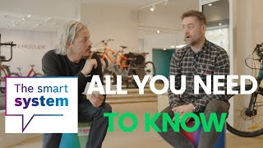
THE BOSCH
EBIKE SYSTEM
Before showing you the type of Moustache’s available, it’s important that we all understand how an eBike works, and the market-leading system that Moustache’s are built off… Bosch!
As an electric assisted bike, your Moustache’s power is assisted by a torque sensor, built into the bottom bracket. The torque sensor senses how hard you're working and how hard you’re having to work via other sensors and a sophisticated control system adds assistance to the bike.
Bosch products measure your pedalling at 1,000 per second, offering you the smoothest and most intuitive ride out of any eBike system!
View our latest Bosch Smart System video with the Bosch UK team here

Slide 16
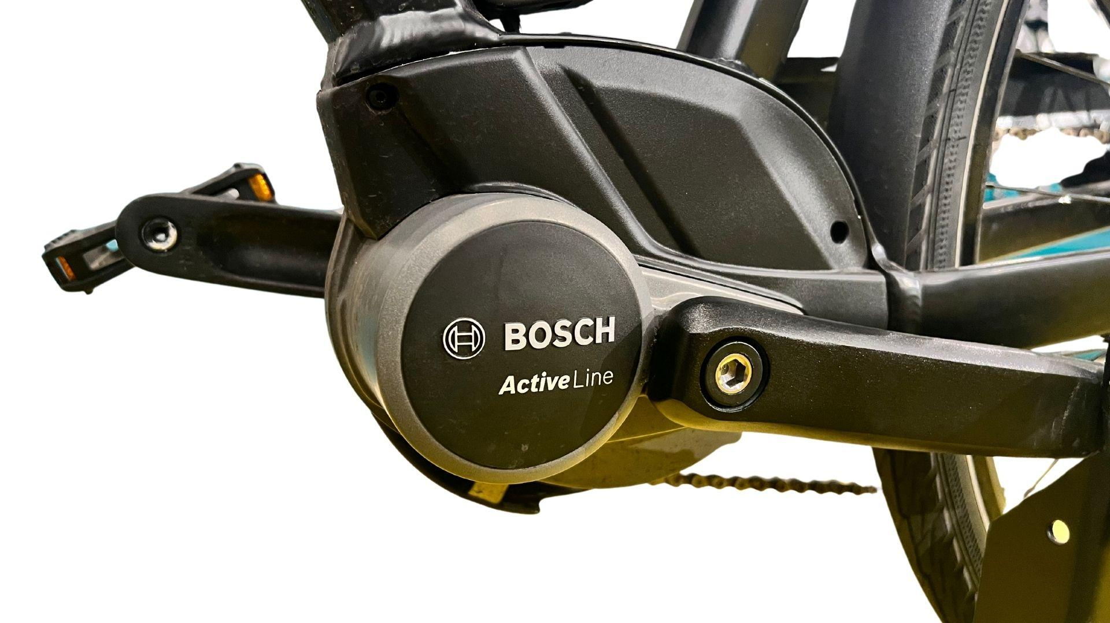
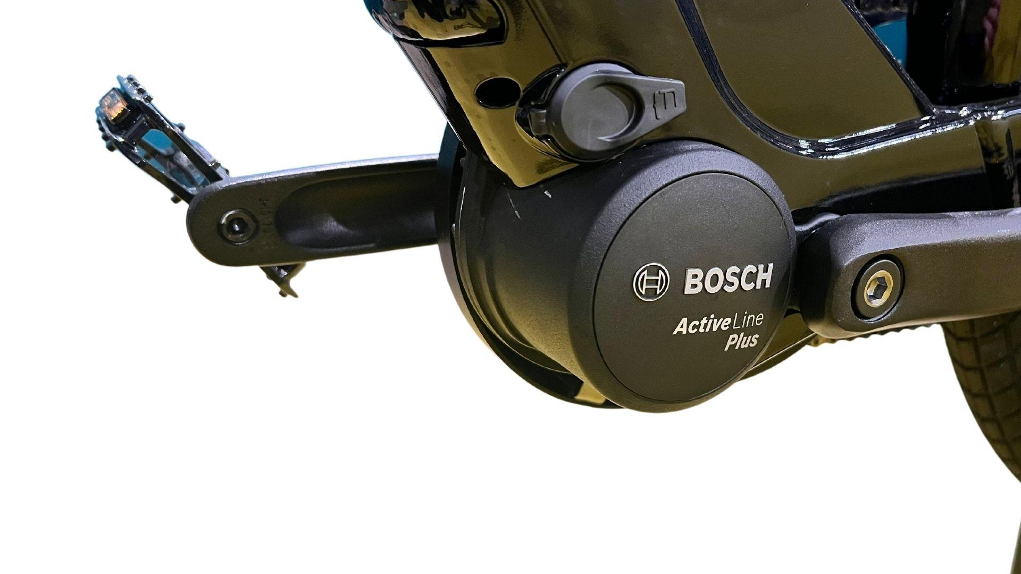
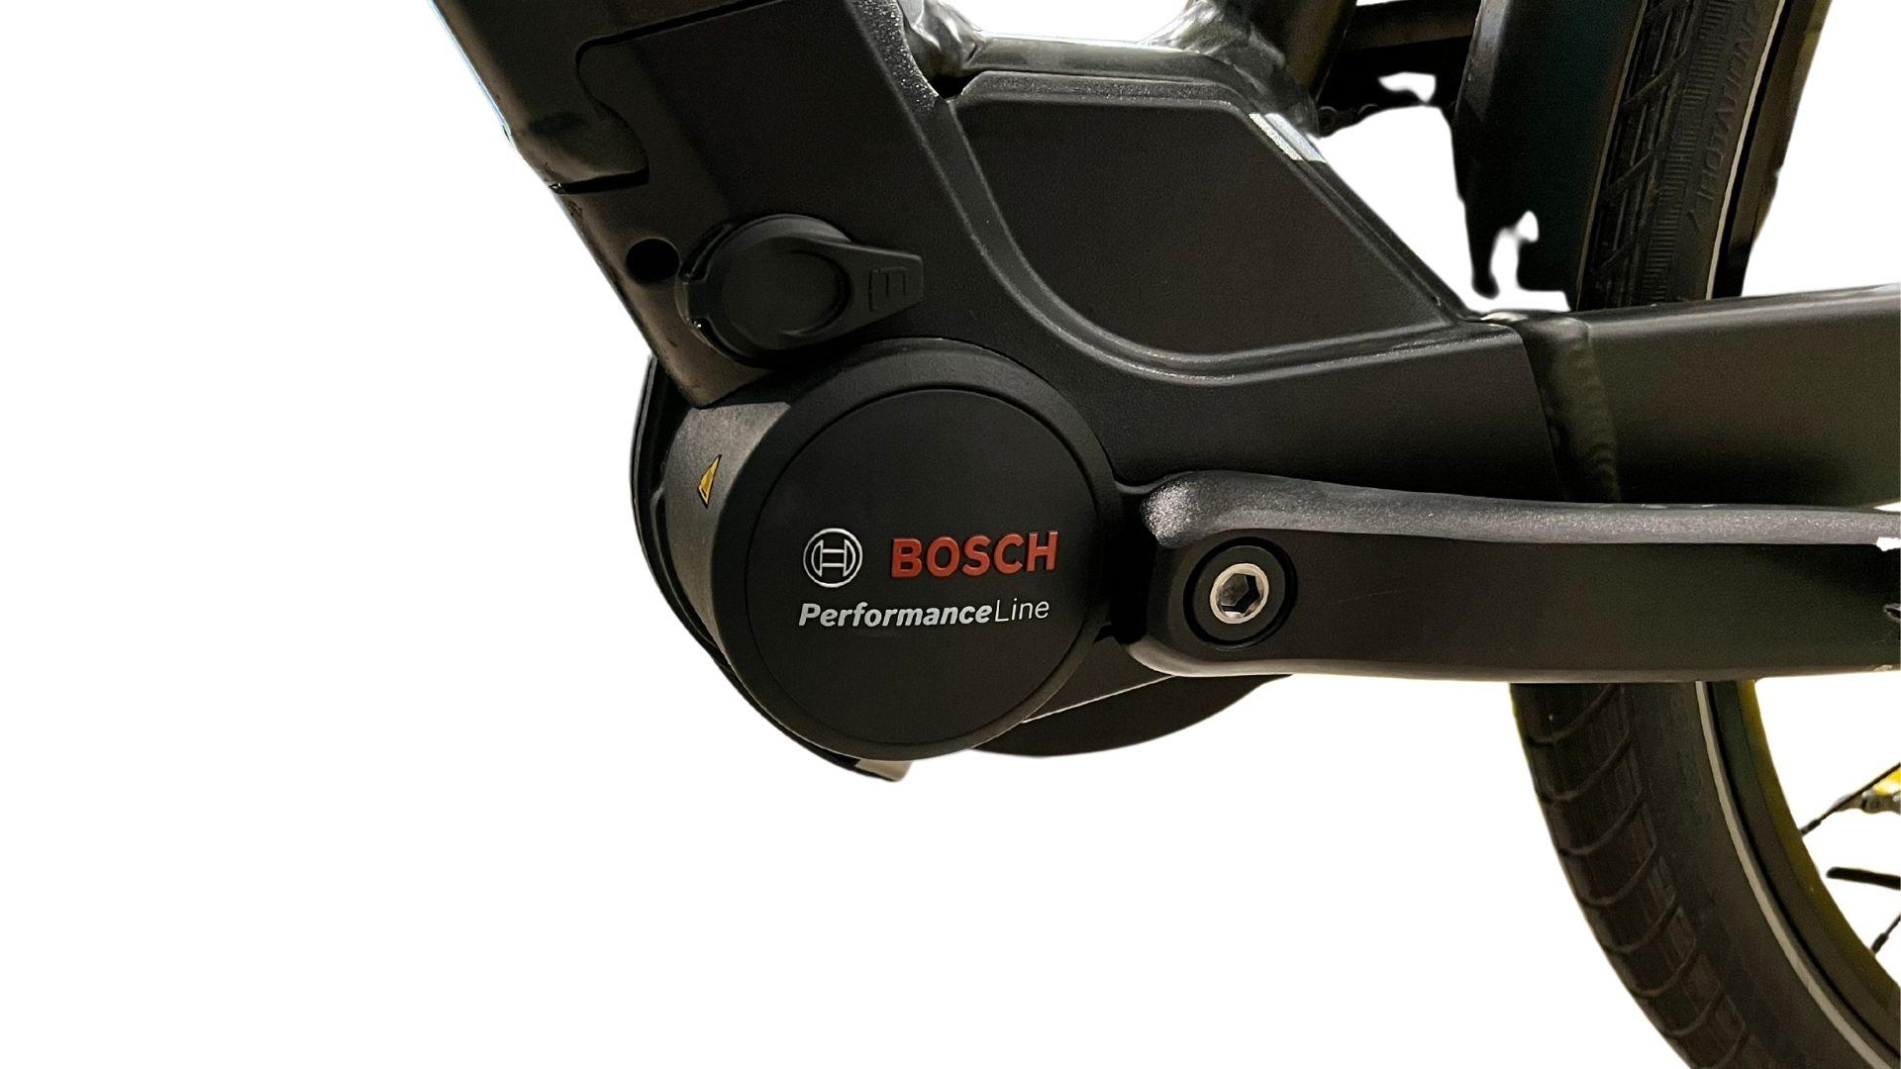
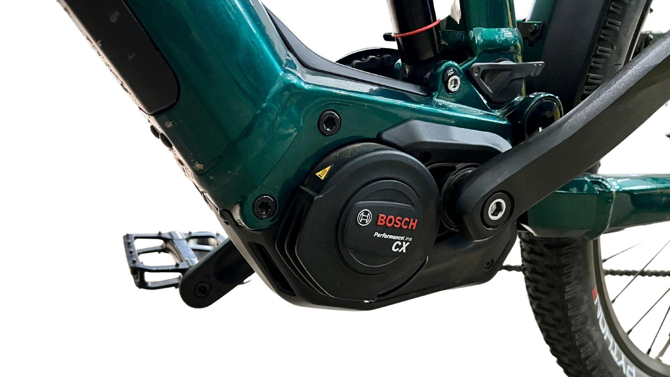
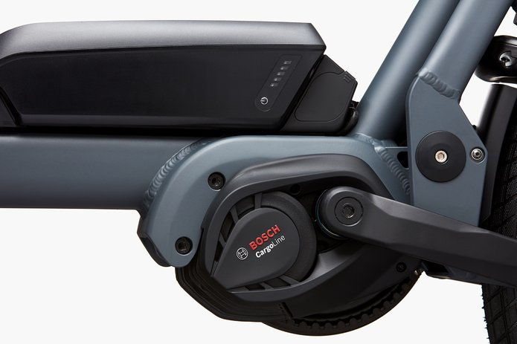
MOTOR
Moustache motors use either the Active Live, Active Line Plus, Performance Line, The Performance Line CX or the Cargo Line motor from Bosch.* The further you go up through the motos, the higher torque they have with greater assistance, and therefore consuming more energy from the battery and resulting in a reduced range.
Active Line Motor
The Moustache Samedi 28.1 uses the Active Line motor. This motor uses 250% pedal assistance and 40Nm of torque. It is the smallest and lightest drive and is the ideal choice for anyone who wants moderate support during routine cycling trips.
Active Line Plus Motor
Uses 270% pedal assistance and 50Nm of torque. It is a versatile solution for city trips and light touring.
Performance Line
Uses 300% pedal assistance and can get up to 75Nm of torque, offering plenty of power for city use, as well as touring options.
Performance Line CX
The top of the line consumer motor, offering 340% pedal assistance and 85Nm of torque… which if needed would make any hill quiver in its boots!
Cargo Line
Enter the beast! The Cargo Line motor, designed for the Moustache Lundi 20.3, has 400% pedal assistance and 85Nm of torque - which can carry your kids or heavy loads with ease across any terrain.
*Moustache also have the Performance Line Speed motor with their Friday 27 FS Speed model.

Slide 17
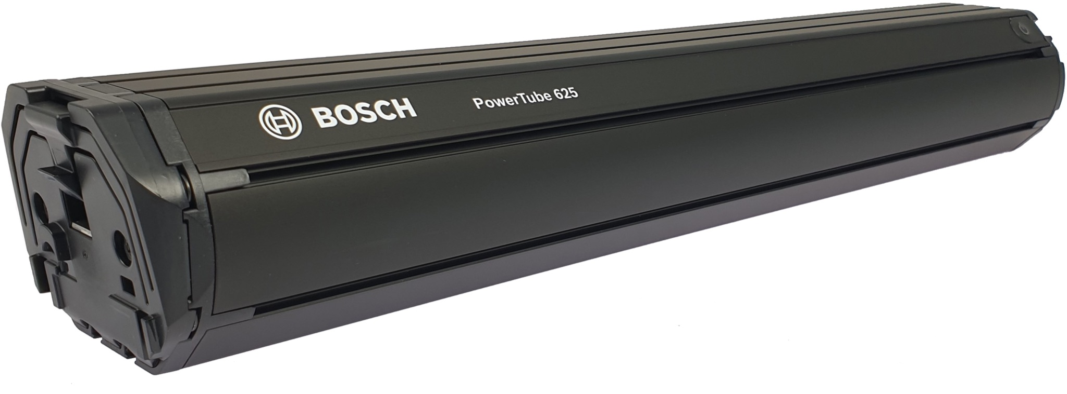
BATTERIES
With Bosch you have either a 400Wh, 500Wh, 545Wh or 725Wh PowerPack battery, which is fitted on the frame of each bike, or you have a 400Wh, 500Wh, 625Wh or 750Wh PowerTube battery which is fitted discreetly in the downtube of each bike*. The higher the Watt-Hours, the more range you get.
Depending on the size of your battery and which charger you have, it typically takes between 3 - 5 hours for a full charge.
Moustache provide the option of DualBattery configuration on certain bikes, which means you can get 1000Wh, 1125Wh or even up to 1250Wh of battery range on some products!
*excluding the Swing3 and the DualBattery Nevo3 which comes with an exposed rear battery pack from Bosch.

Slide 18
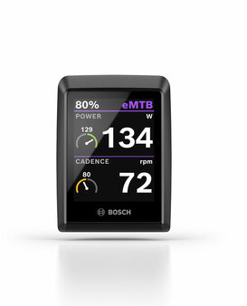
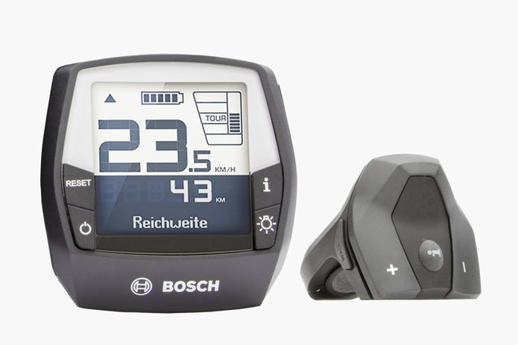
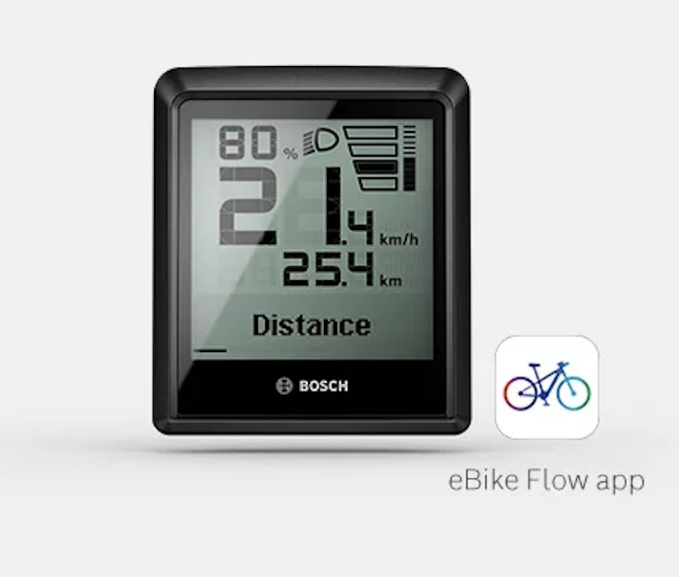
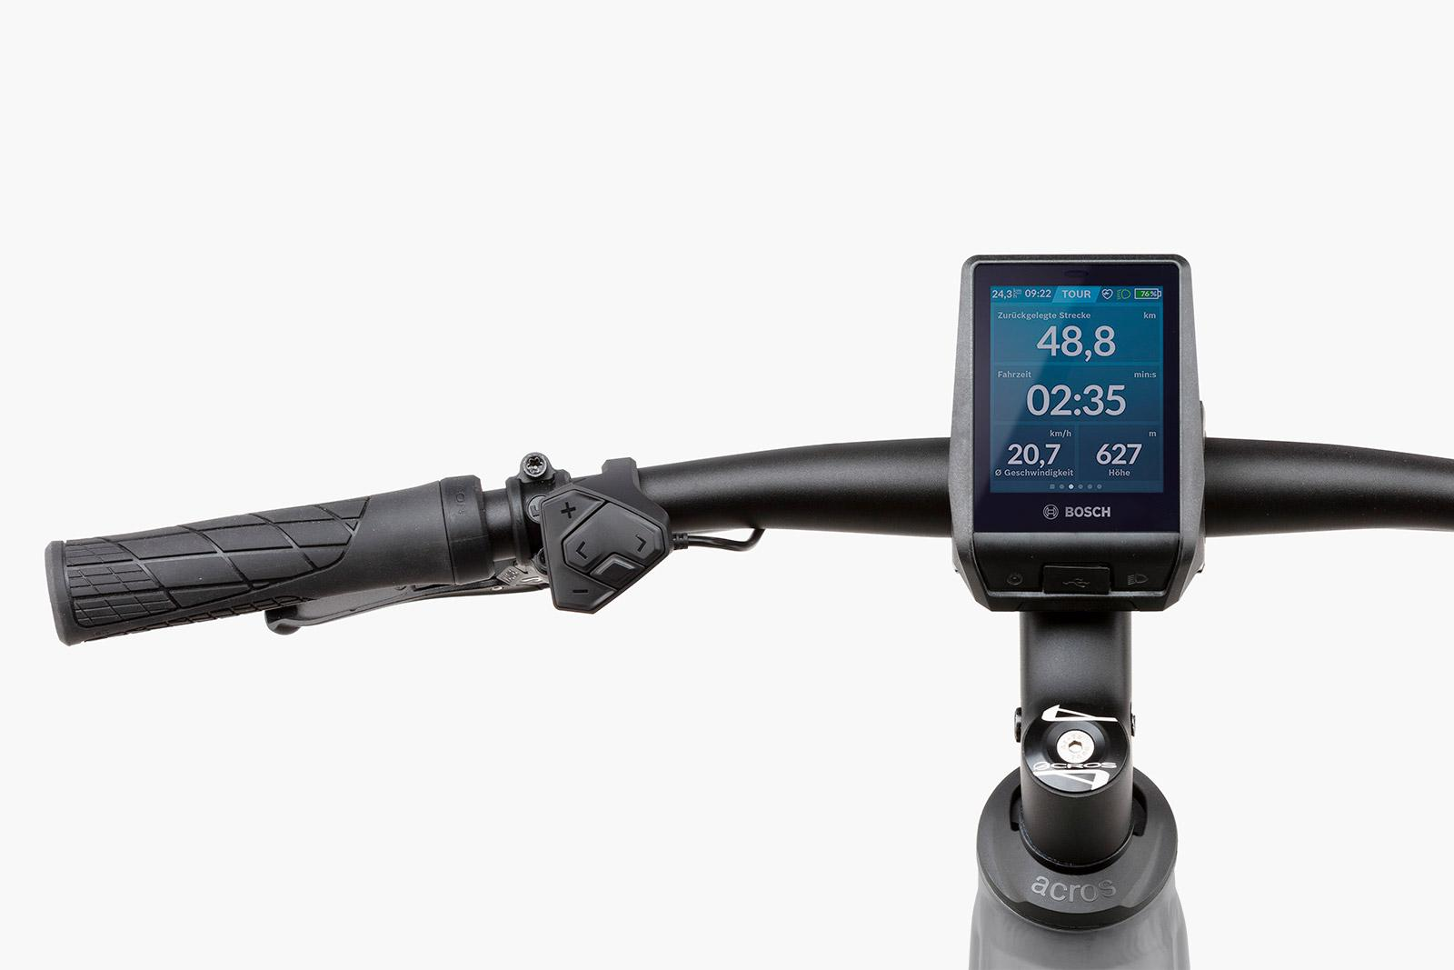
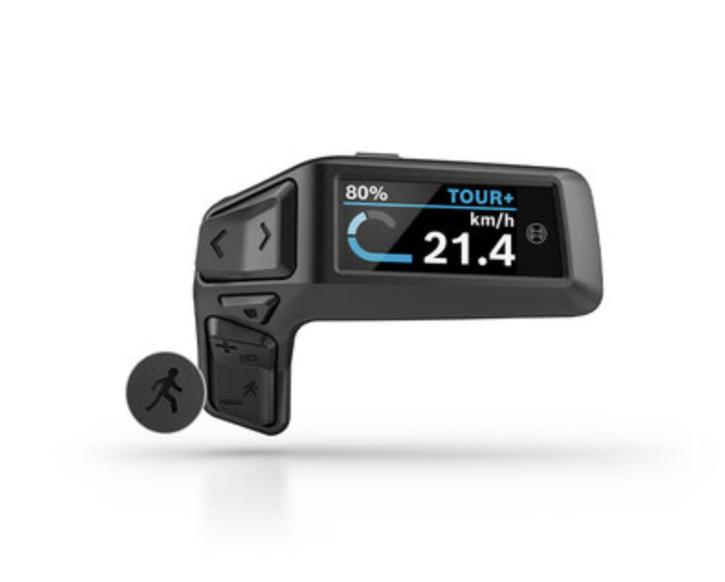
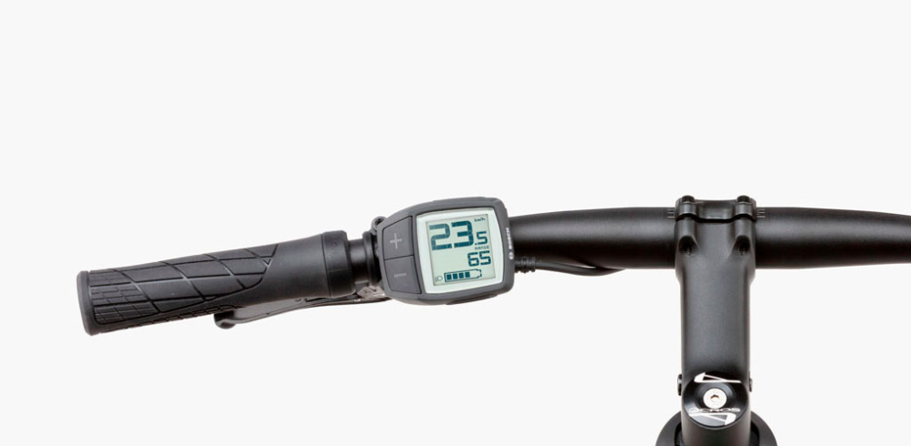
DISPLAYS
In their simplest form, each display will offer the following information:
How fast the bike is going - Simply put, this shows you how quickly the bike is going.
Assistance Mode - What level of assistance your eBike is in battery charge status.
Battery Range - How many miles you have left on a single charge, dependent on your level of assistance.
Trip Distance - How many miles the bike has done in one trip.
Odometer - How many miles the bike has done in its lifetime.
INTUVIA
A large display screen that is capable of being dismounted. Simple and practical.
KIOX 300
Offering more features, including limited GPS tracking and data functionality. Dismountable, too.
INTUVIA 100
An intuitive & clear display for Bosch Smart System.
PURION 200
The Purion 200 offers numerous functions that let you ride and arrive better. In addition to basic functions (such as switching your eBike and the light on and off)
NYON
The cats pyjamas! The Nyon offers sat-navigation as well as a host of different GPS and data functionality and is removable.
PURION
The entry level option that is fixed to the handlebar.

Slide 19
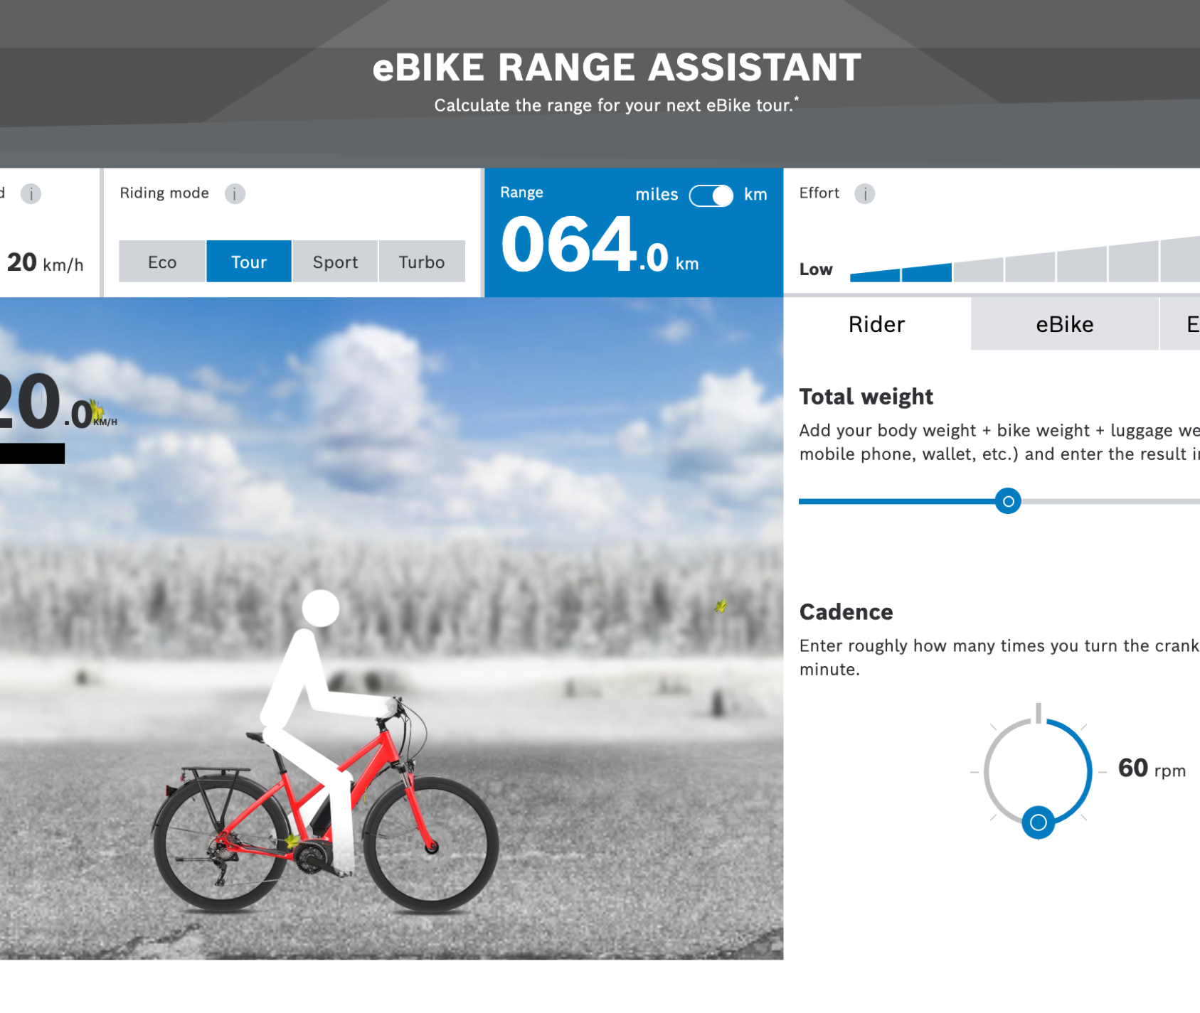
RANGE
Range is a tricky subject and influenced by a multitude of factors including rider weight, terrain, your motor, assistance mode, riding style etc. Like it’s difficult to estimate the MPG of a car, the same is true with an eBIke. Bosch has developed a handy tool called the
Bosch eBIke Range Calculator.
The range you get on your Riese & Müller is dependent on the type of motor and the of your battery - measured in Watt-Hours.

Slide 20
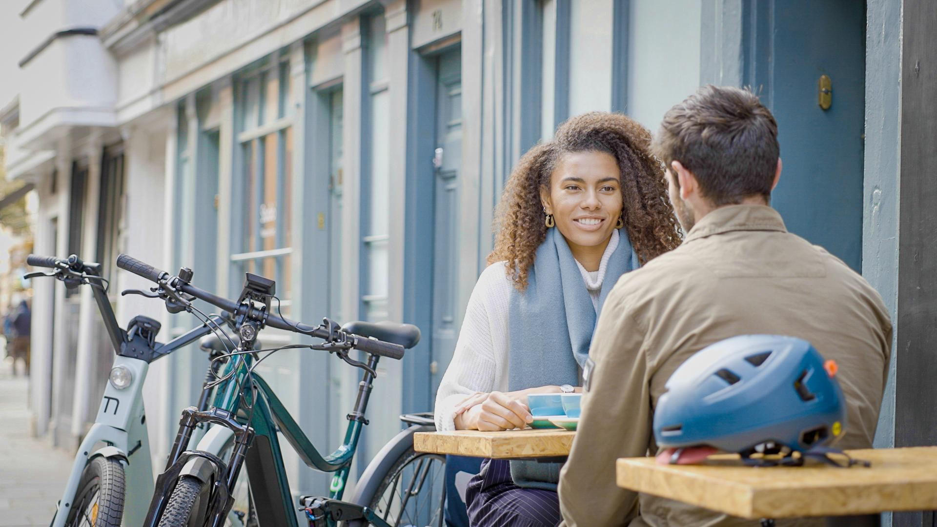

OUR FAVOURITE MOUSTACHE EBIKES

Slide 21
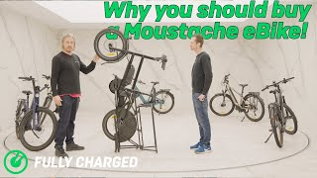
SEE OUR MOUSTACHE PRODUCT OVERVIEW

Slide 22
NEW 2024
MOUSTACHE EBIKES

Slide 23
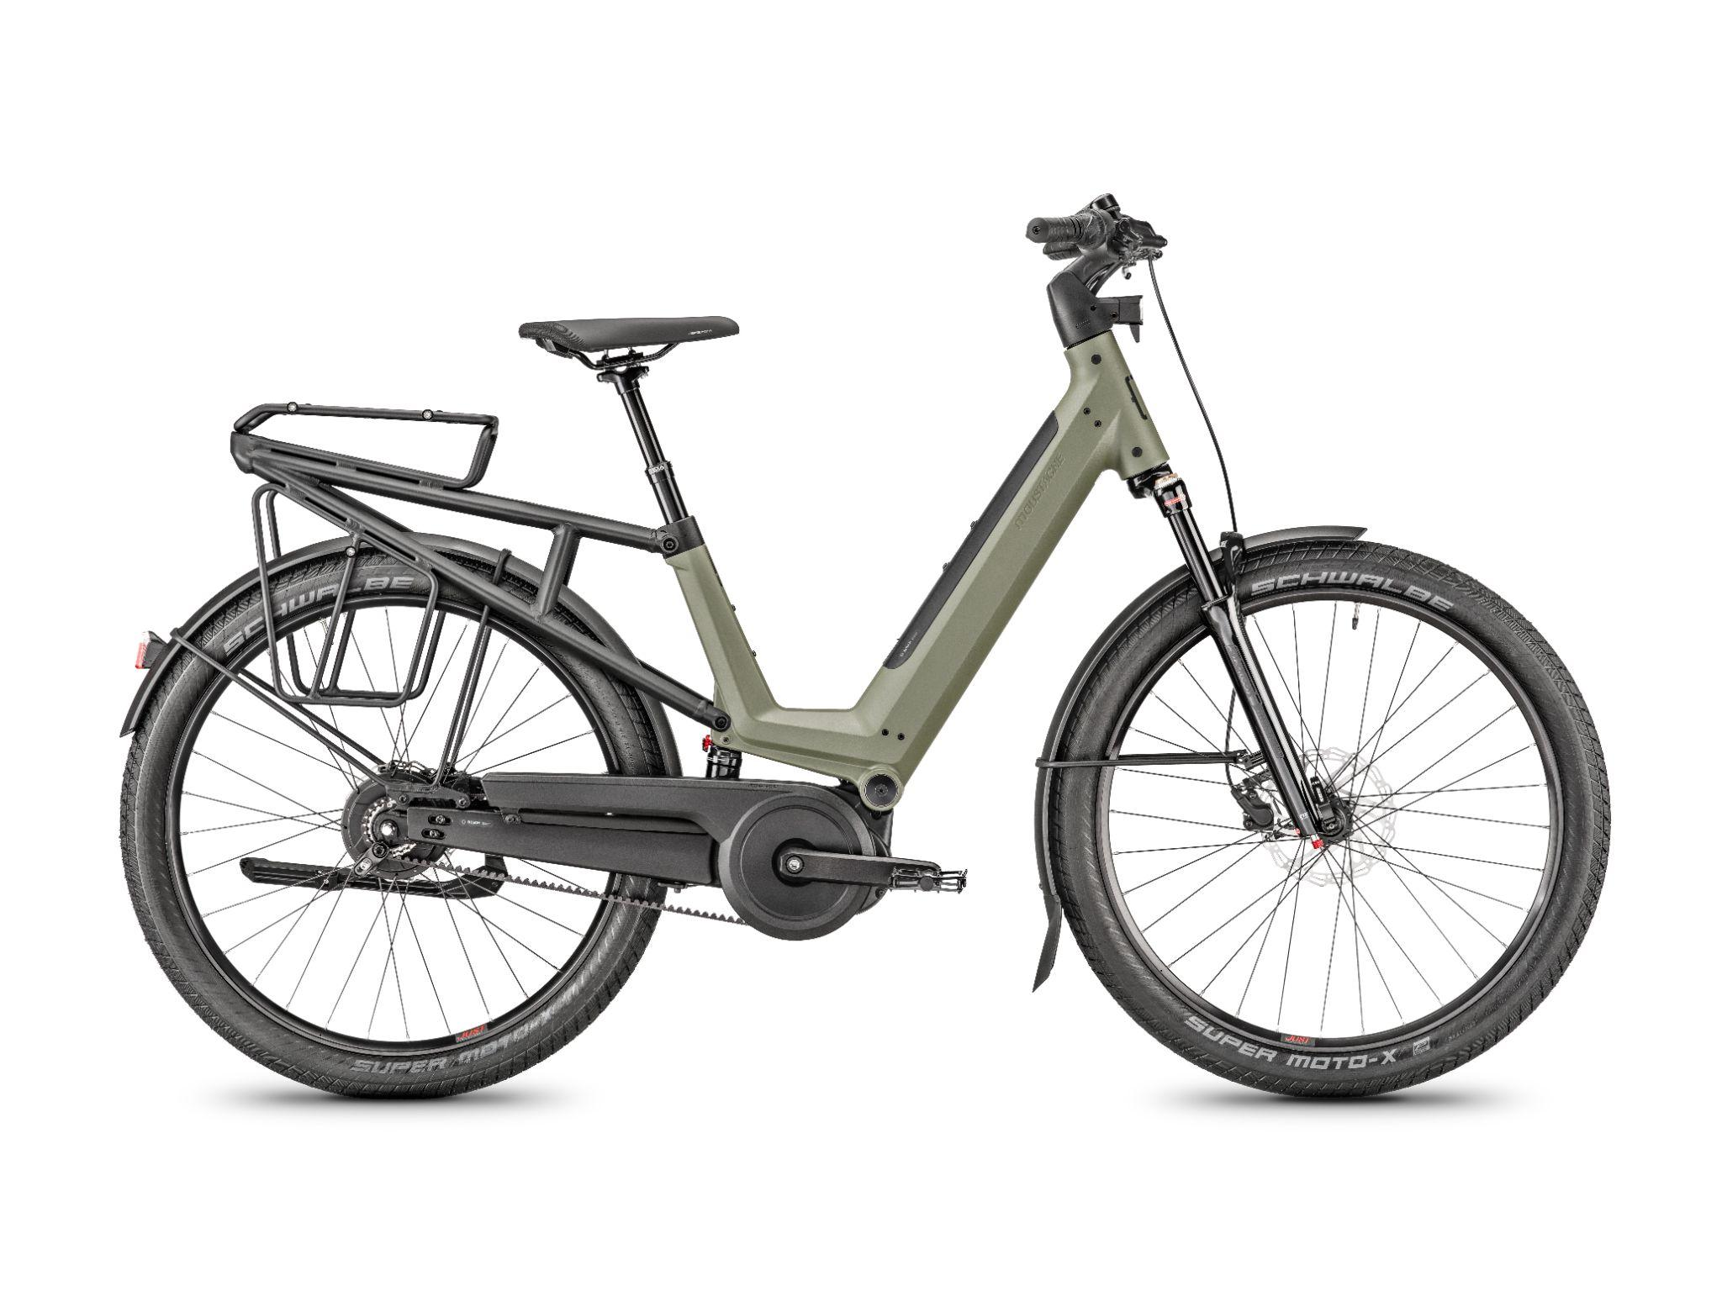
MOUSTACHE
J SERIES
Adjustable handlebar and integrated lights, so you can find your sweet spot position.
Step-through for easy access
Dropper seatpost that means feet can
Hit the ground.
Full-suspension for optimum comfort
Front suspension
Rear rack options available, including PBS rack, up to 27kg of carrying capability.
Integrated,
removable battery
Superstrong
tubular aluminium
mudguards
Either 27.5” Schwalbe
Super Moto-X tyres or Jonny Watts 27.5 X 60.
Bosch Smart System available with Moustache J
(Bosch ConnectModule pre-installed)
Gates Carbon Belt Drive and Enviolo gearing

Slide 24
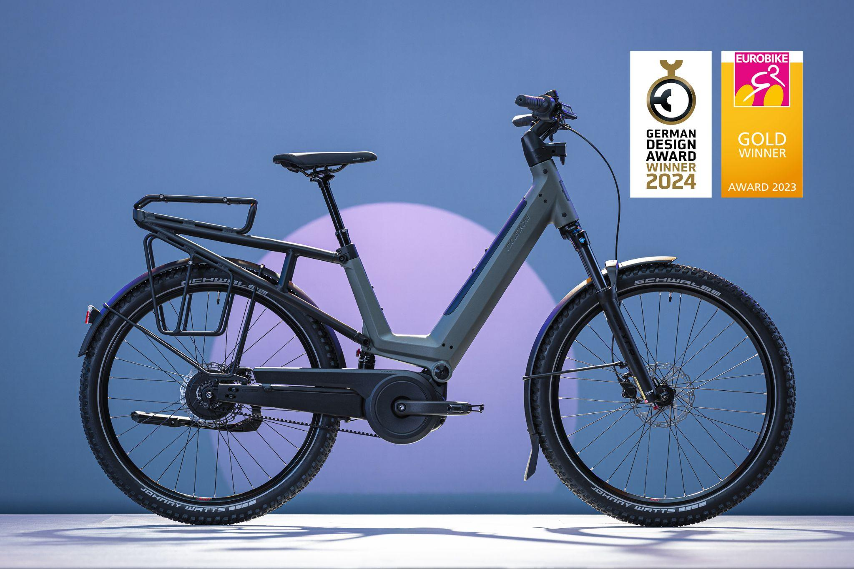
J SERIES
PRODUCT PAGES
J ON
Commuter option
PBLrack look for minimalist design look
Enviolo & Gates Carbon Belt Drive
To view the product page click here.
J ALL
Hybrid option
PBS or PBL rack dependent on usage
500Wh Bosch Powertube battery
Enviolo & Gates Carbon Belt Drive
To view the product page click here.
Ben’s review of the Moustache J is HERE.
There is also the Moustache J ‘OFF’ model, which we can order upon request.

Slide 25
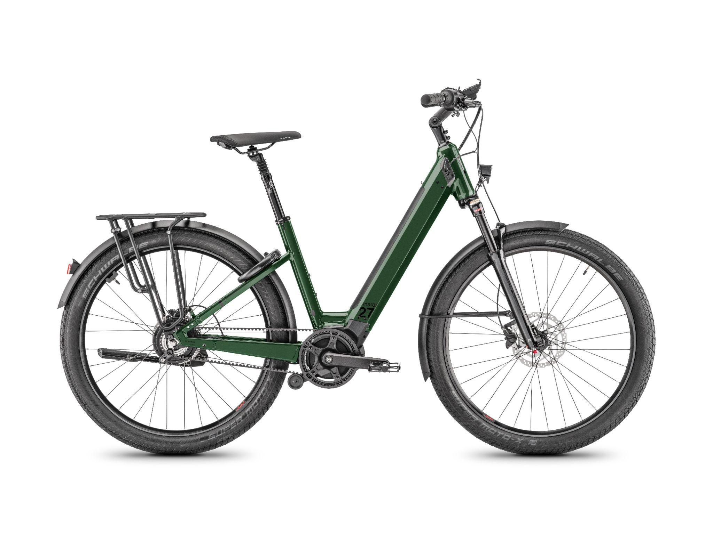
MOUSTACHE
MARDI SERIES
Adjustable handlebar stem and Bosch Smartphone Grip cockpit
Step-through for easy access
Cushioned seatpost for extra comfort in the saddle
Front suspension
Rear wheel lock pre-installed
Rear rack MIK HID compatible, can carry a child
Integrated,
removable battery
Superstrong
tubular aluminium
mudguards
27.5” Schwalbe
Super Moto-X tyres
Bosch Smart System available with Moustache Mardi Series
(Bosch ConnectModule pre-installed on Mardi 26.7)
Gates Carbon Belt Drive and Enviolo gearing*
(*comes as standard with the Mardi 26.7)

Slide 26
OUR MOUSTACHE EBIKES

Slide 27
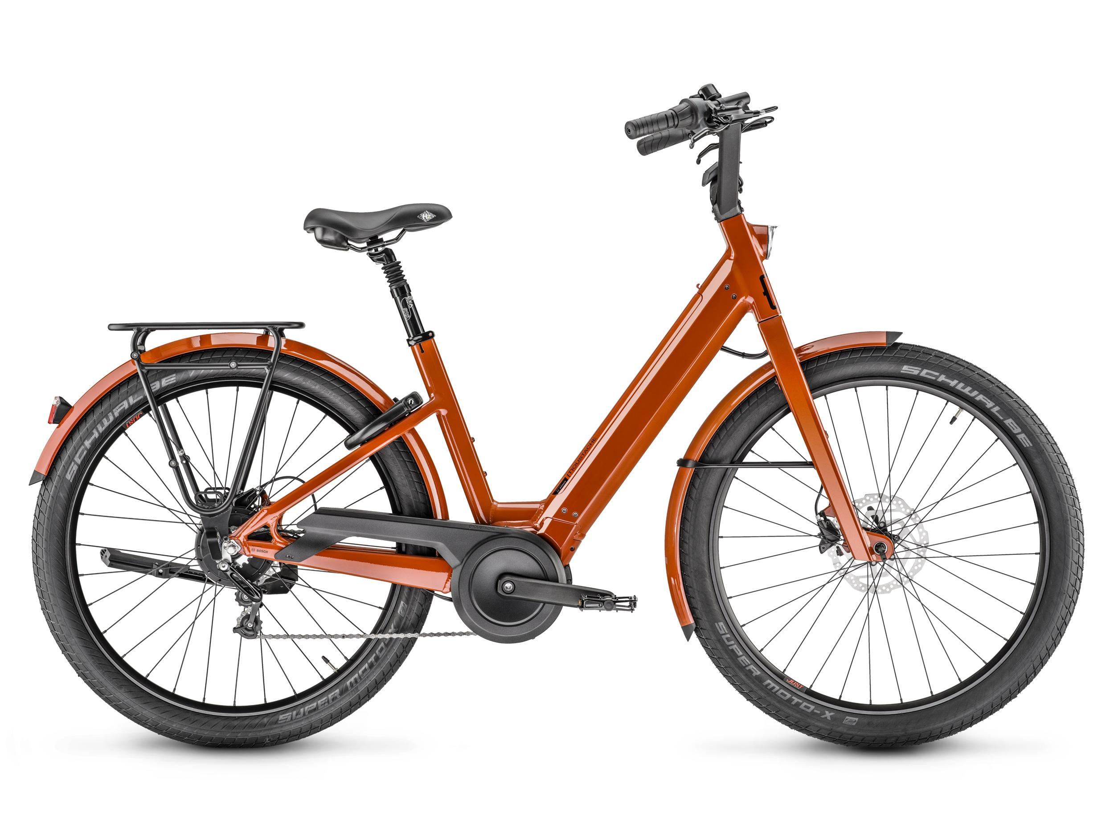
MOUSTACHE
LUNDI 27
Emblematic ‘Moustache’ handlebars
for a more upright, comfortable position
Step-through for easy access
Suspension underneath
the saddle for supreme comfort
Rear wheel AXA lock
LED integrated light (front and rear)
Rear rack options
Integrated,
removable battery
Superstrong
tubular aluminium
mudguards
27.5” Schwalbe
Super Moto-X tyres
Bosch Smart System available with Lundi 27.5

Slide 28
LUNDI
PRODUCT PAGE
LUNDI 27.1
Bosch Active Line Plus motor
400Wh Bosch PowerTube battery
Shimano Deore XT, 10 speed derailleur gearing system
To view the product page click here.
LUNDI 27.5
Bosch Smart System
Bosch Performance Line motor
500Wh Bosch Powertube battery
Enviolo 380 gearing system
To view the product page click here.
Lewis’ review of the Moustache Lundi

Slide 29
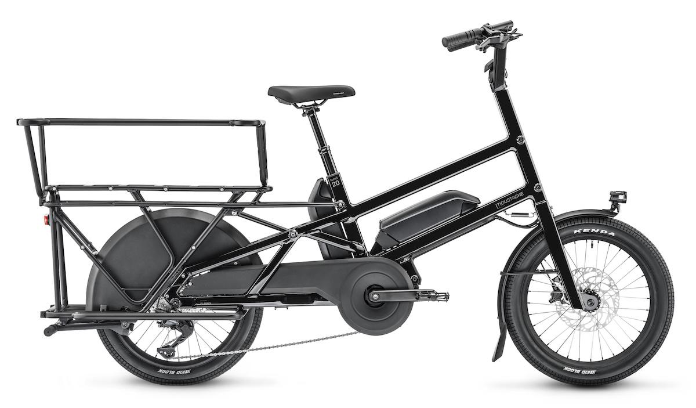
MOUSTACHE
LUNDI 20
200kg of gross vehicle weight
Emblematic ‘Moustache’ handlebars
for a more upright, comfortable position
Suspension seat post and dropper
Triple cavity tubed frame
Capable of taking two children on the rear rack
Optional
DualBattery Configuration
‘Albert’ protective railing comes inclusive with each purchase
Bosch CargoLine motor
To view the product page of the Lundi 20.3 click here
To view the product page of the Lundi 20.3 Dual click here
To view the product page of the Lundi 20.5 click here
To view the product page of the Lundi 20.5 Dual click here
Chain Guard

Slide 30
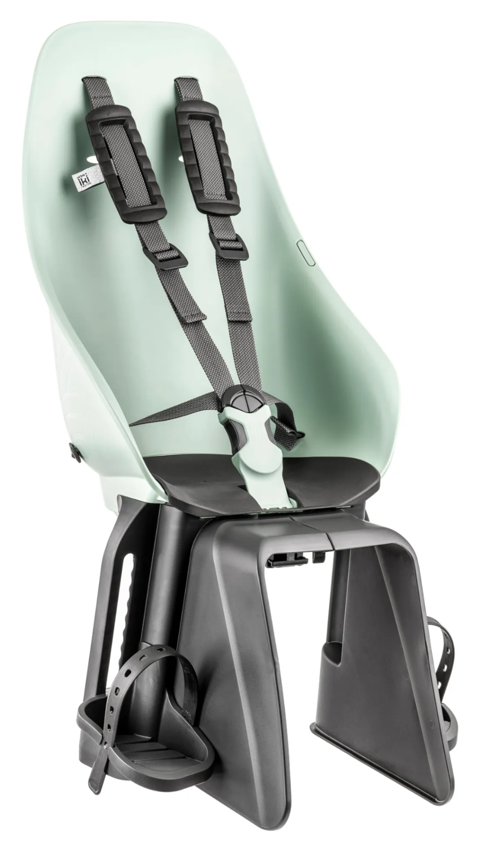
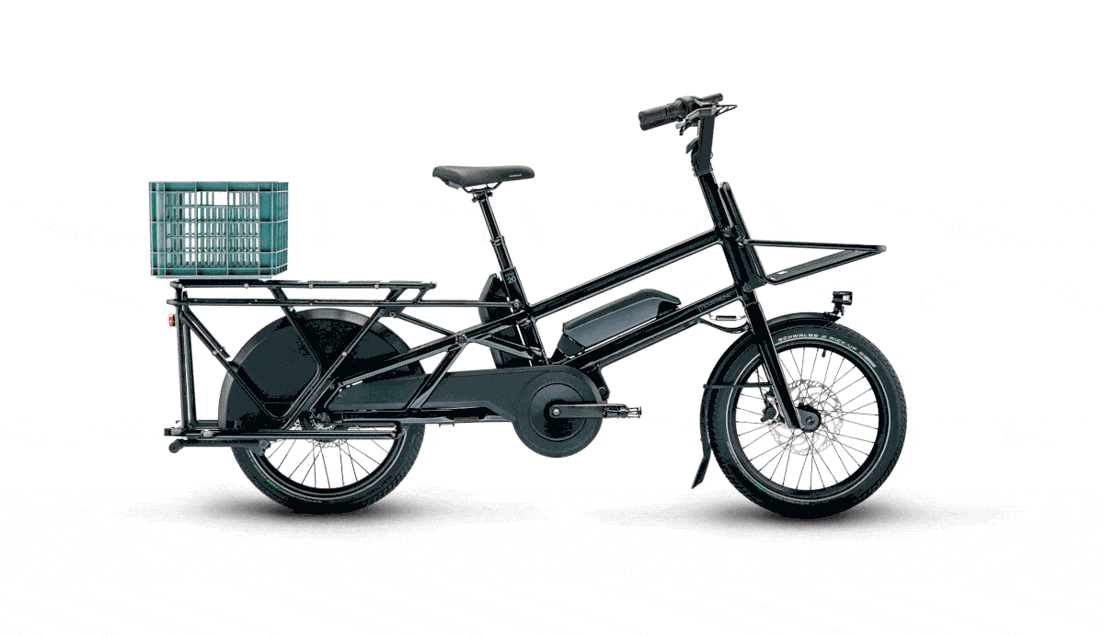
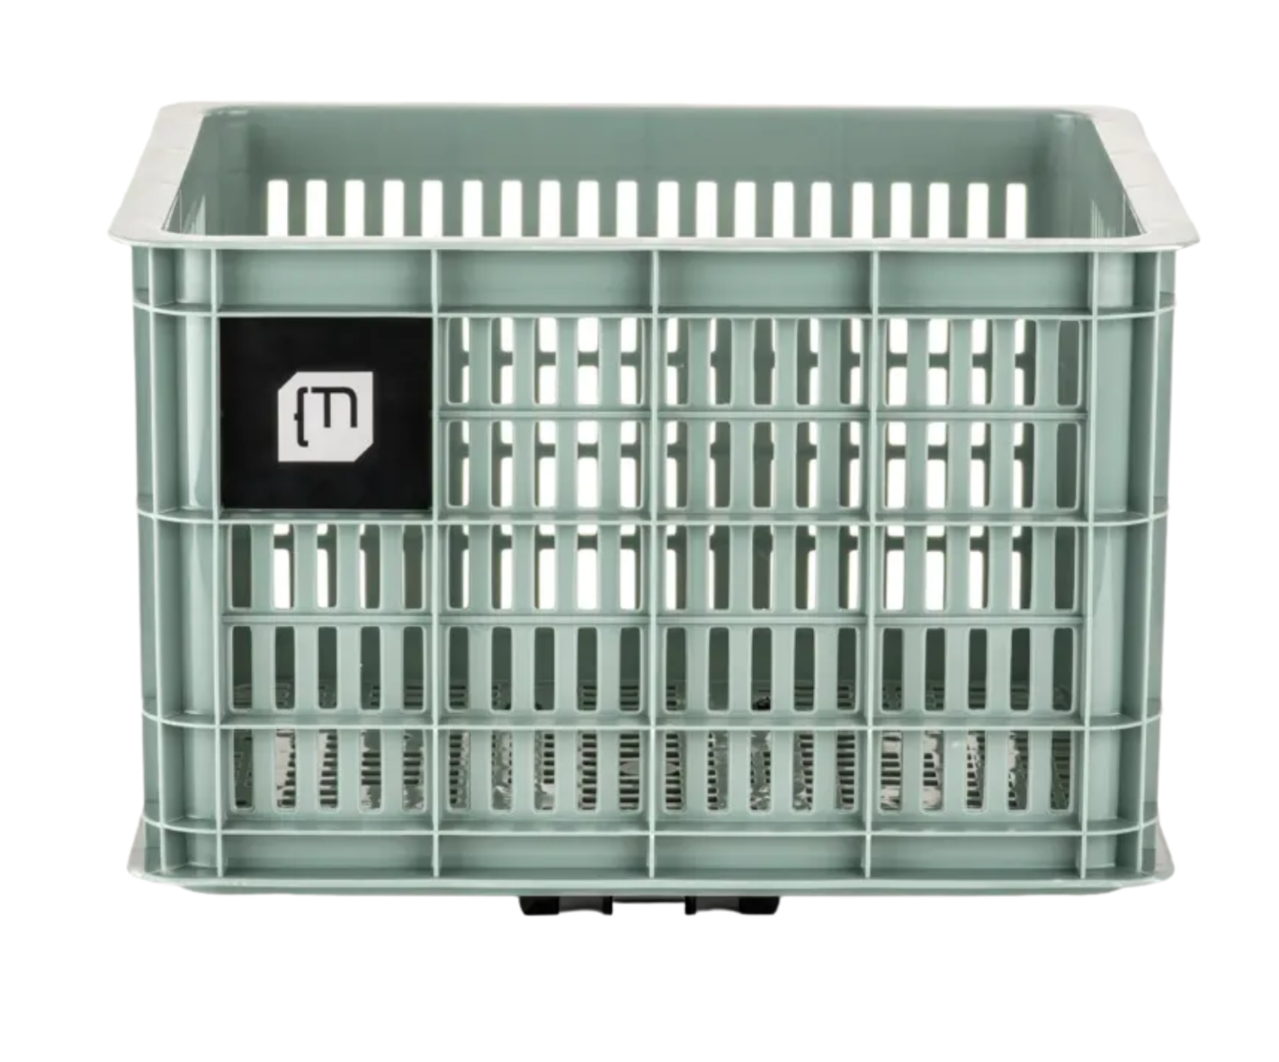
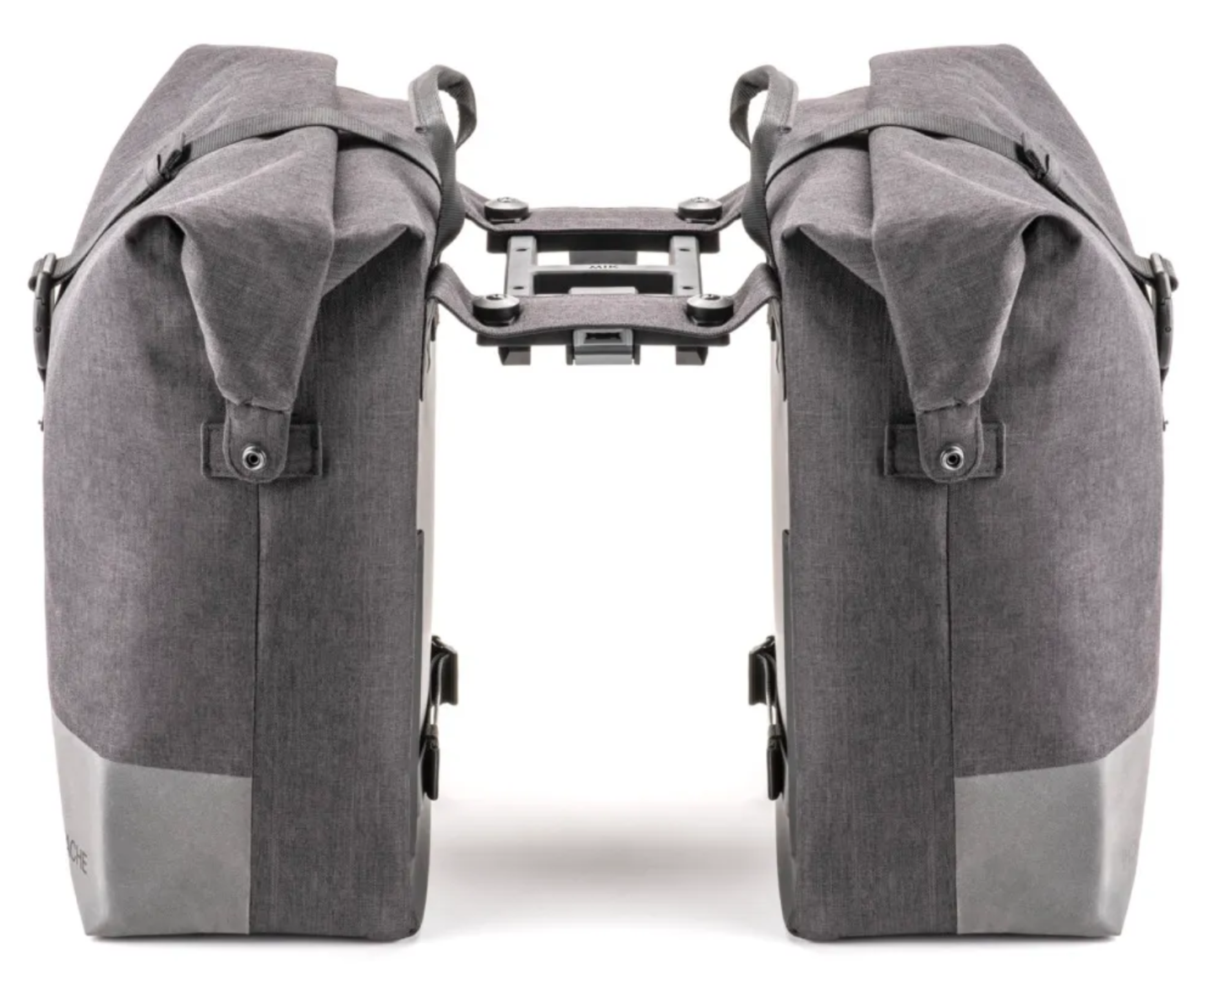
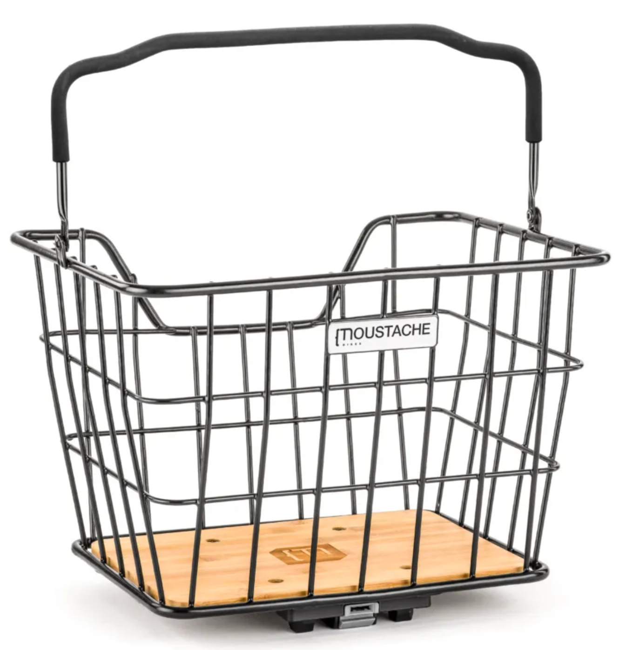
FLEXIBLE & FAMILY FRIENDLY
33 Kg MIK - Frida Crate
MIK HD 22Kg Child Seat by Urban IKI
Greg & Manu 44L Double Pannier
MIK 23L - Salvador Basket

Slide 31
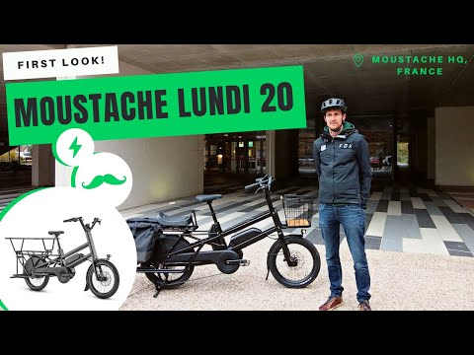
SEE OUR
LUNDI 20
FIRST LOOK

Slide 32
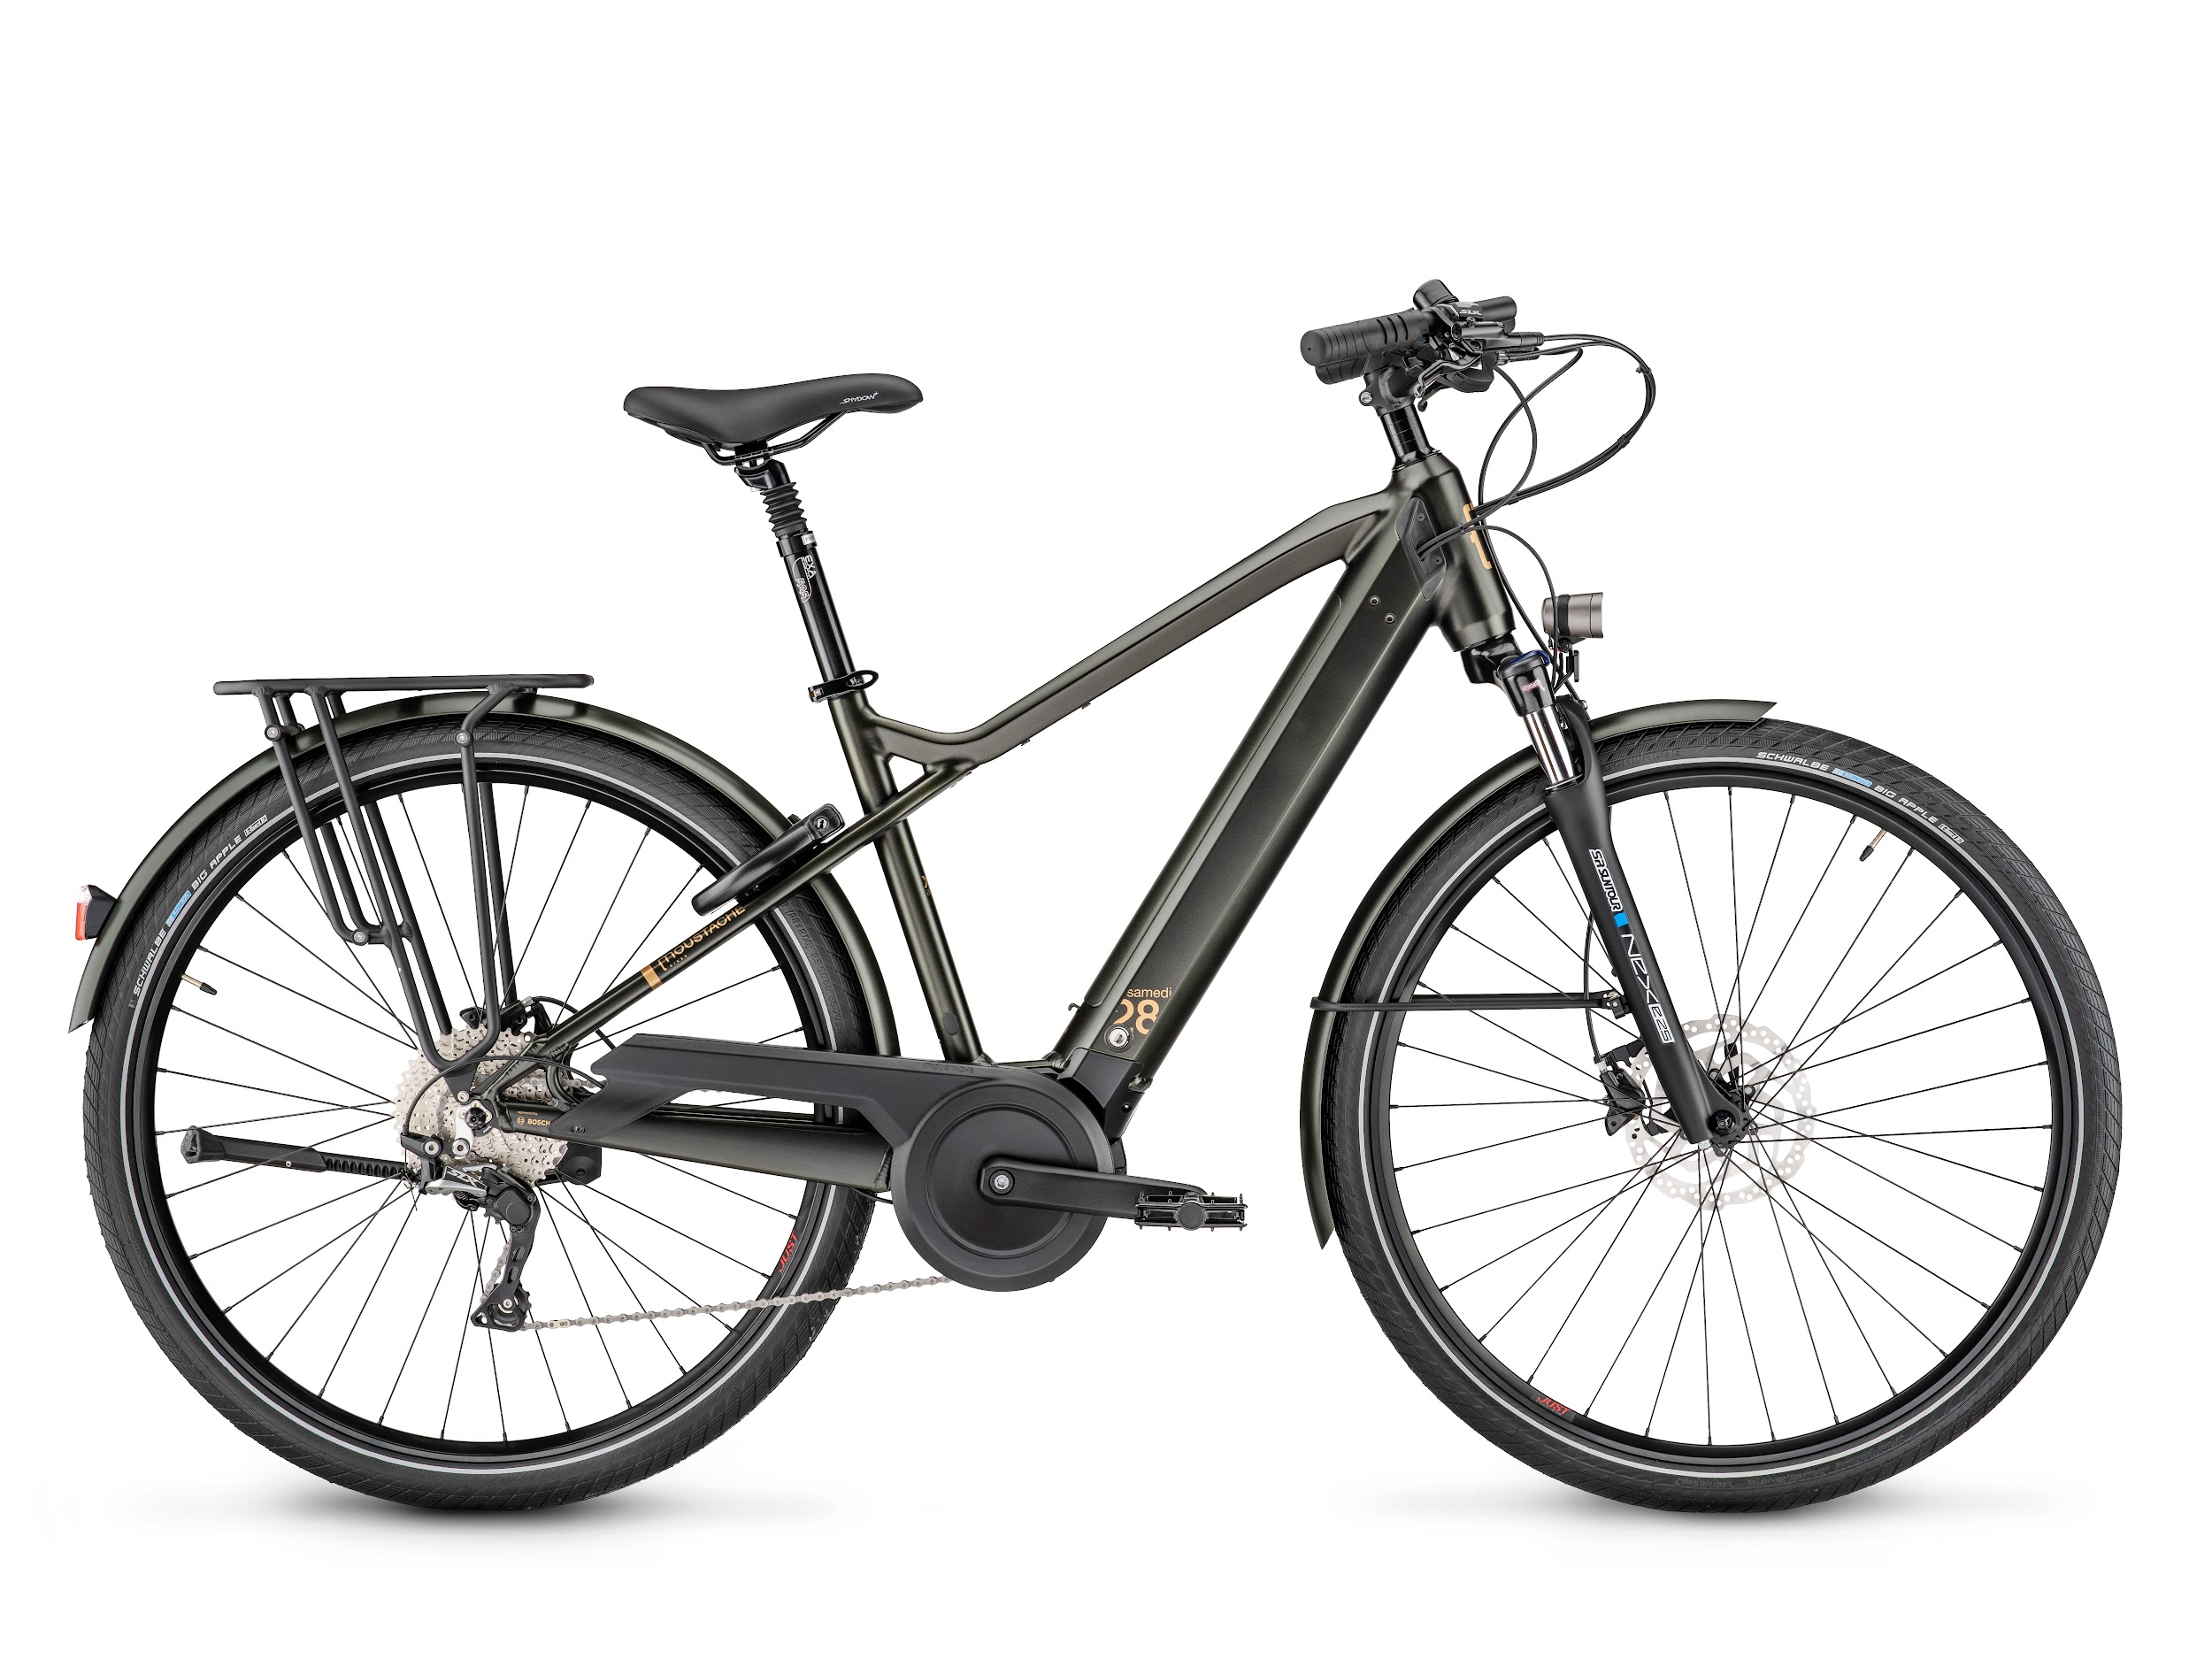
MOUSTACHE
SAMEDI 28
Emblematic ‘Moustache’ handlebars
for a more upright, comfortable position
Either Step-through for an open or closed frame
Suspension underneath
the saddle for supreme comfort
Front Suntour suspension
Rear rack options
Integrated, removable battery
Superstrong
tubular aluminium
mudguards
Schwalbe 28” tyres
Bosch Smart System available with Samedi 28.7
(Bosch ConnectModule pre-installed!)

Slide 33
SAMEDI 28
PRODUCT PAGE
SAMEDI 28.1
Bosch Active Line motor
400Wh Bosch PowerPack battery
Shimano Deore XT, 9 speed
derailleur gearing system
To view the Samedi 28.1 click here
To view the Samedi 28.1 Open click here
SAMEDI 28.2
Bosch Active Line Plus motor
400Wh Bosch PowerTube battery
Shimano Deore XT, 9 speed
derailleur gearing system
To view the Samedi 28.2 click here
To view the Samedi 28.2 Open click here
SAMEDI 28.3
Bosch Active Line Plus motor
500Wh Bosch PowerTube battery
Shimano Nexus 5=speed drive chain
To view the Samedi 28.3 Closed click here
To view the Samedi 28.3 Open click here
SAMEDI 28.7
Bosch Smart System
Bosch Performance Line motor
625Wh Bosch PowerTube battery
Bosch Nyon display
Shimano SLX 11 speed derailleur
gearing system
To view the Samedi 28.7 click here
To view the Samedi 28.7 Open click here

Slide 34
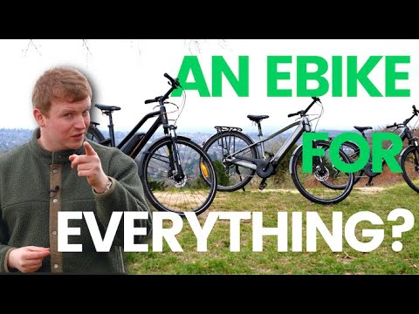
SEE OUR
SAMEDI 28
REVIEW

Slide 35
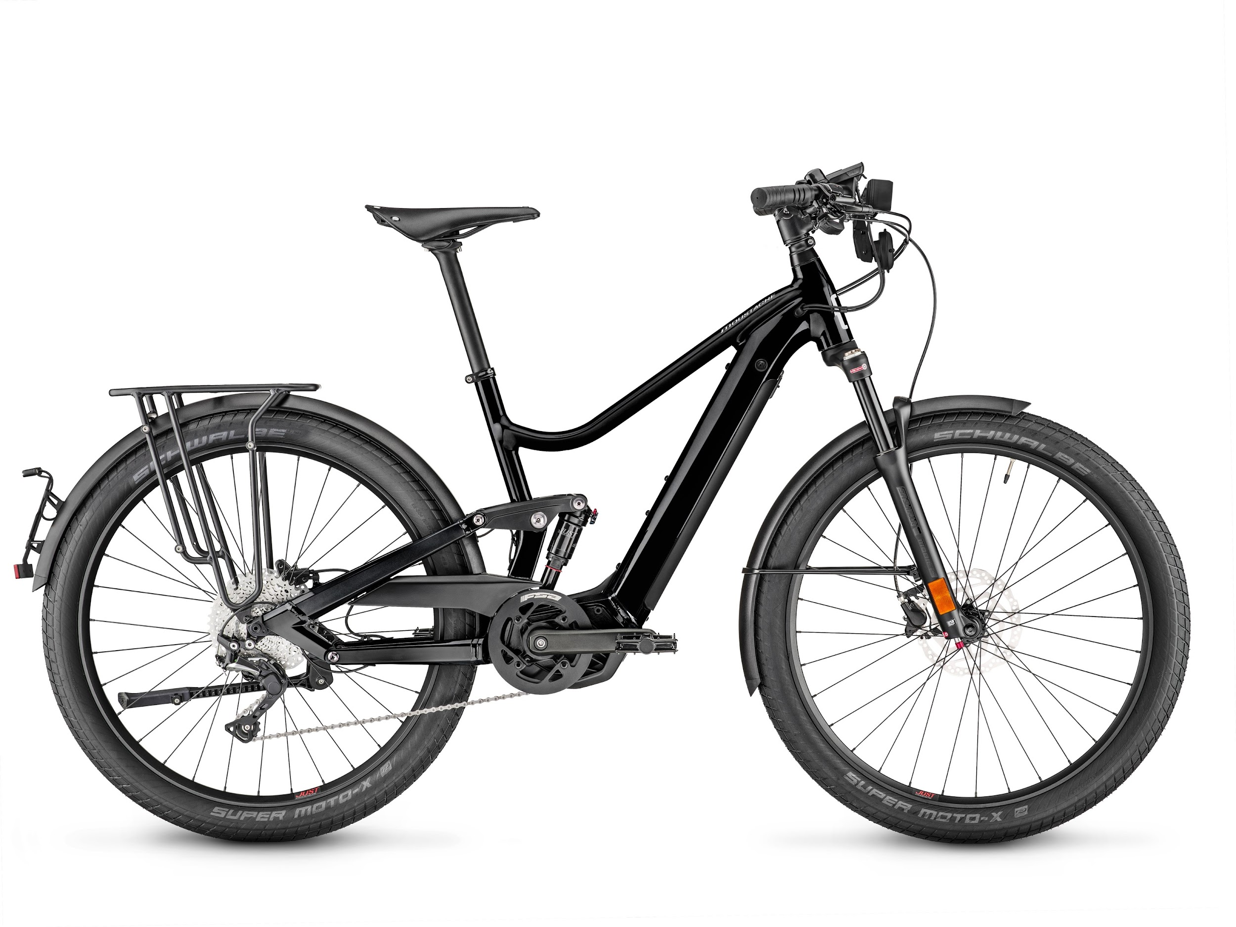
MOUSTACHE
FRIDAY 27 FS SPEED
M99 Mirror
Nyon Display
Rear rack options
Full-suspension
Superstrong
tubular aluminium
mudguards
Up to 1125Wh of battery power (if needed!)
27.5” Schwalbe Super Moto-X tyres
*Please note, The Moustache Friday 27 FS Speed is a ‘speed pedelec’ and can go up to 30mph! For more information surrounding ‘High Speed Electric Bikes’ please follow this link here
To view the product page for the Friday 27 FS please click here
To view the product page for the Friday 27 FS Dual please click here

Slide 36
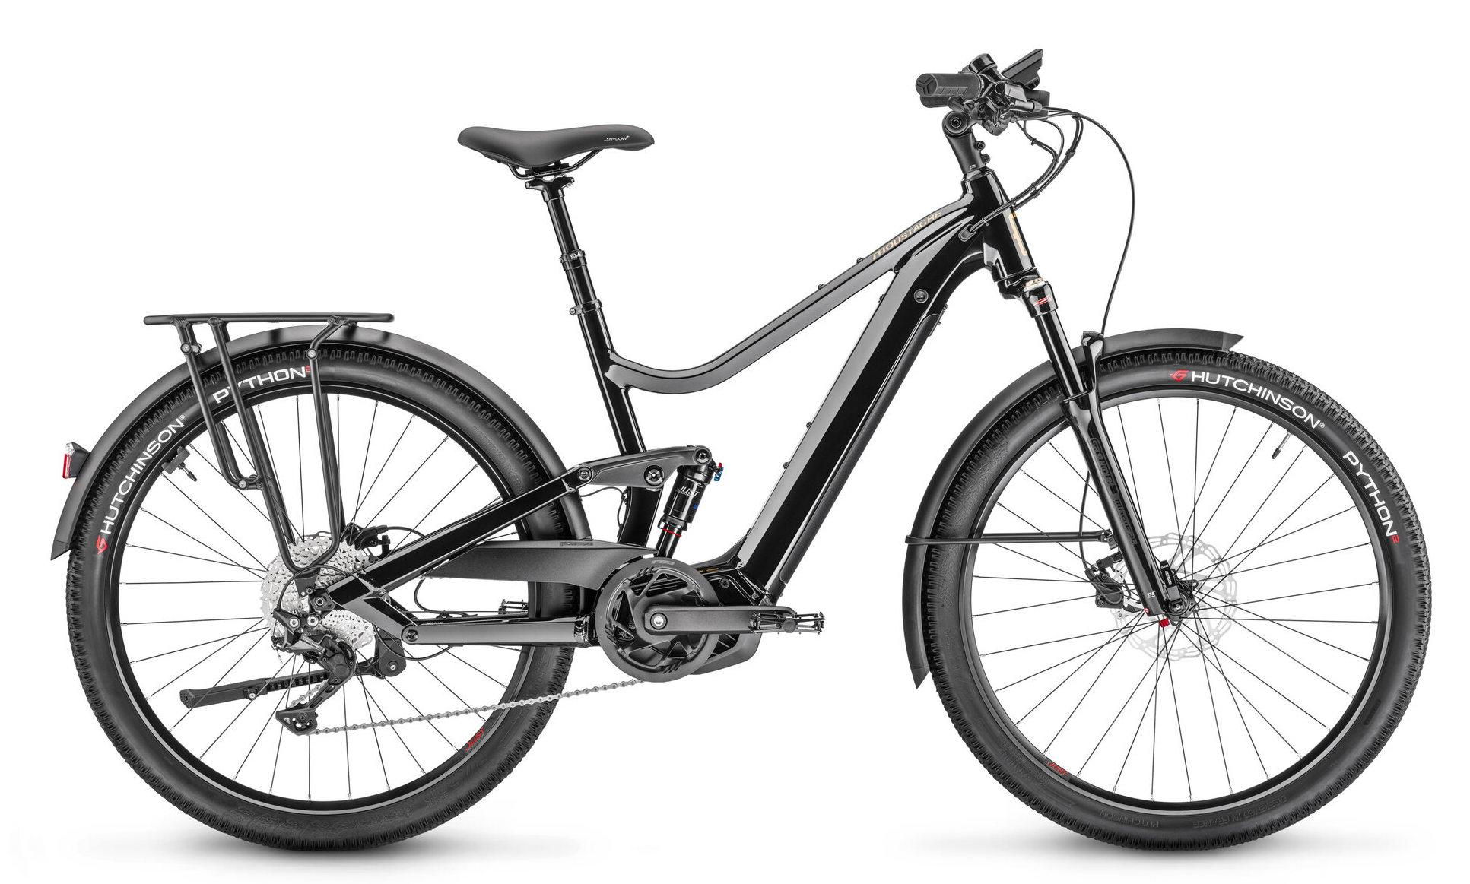
MOUSTACHE
SAMEDI 27 XROAD
(50% on road, 50% off road)
Comfortable geometry
Option of Open/Semi Step through or closed frame
Front Suntour suspension
Rear rack options
Integrated,
removable battery
Superstrong
tubular aluminium
mudguards
Multi-terrain riding
Hutchinson Python
27.5” tyres
Bosch Smart System available on ALL new models except the Samedi 27 Xroad 1

Slide 37
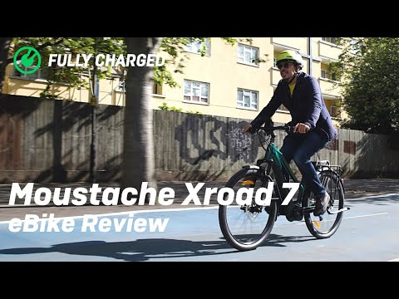


SEE OUR VIDEOS
ON THE XROAD SERIES

Slide 38

SAMEDI 27 XROAD
PRODUCT PAGE
FULLY CHARGED’s BEST SELLER
SAMEDI 27 XROAD 1
Bosch Active Line Plus motor
400Wh PowerTube battery
Shimano 9 speed derailleur gearing system
To view the product page on the Xroad 1 Open click here
To view the product page on the Xroad 1 click here
Ben’s video on the Samedi 27 Xroad 1
SAMEDI 27 XROAD 2
Bosch Smart System
Performance Line motor
500Wh PowerTube battery
Shimano Deore 9 speed gearing system
To view the product page on the Xroad 2 Open click here.
To view the product page on the Xroad 2 click here.
SAMEDI 27 XROAD 3
Bosch Smart System
Bosch Performance Line motor
625Wh PowerTube battery
Shimano Deore 10 speed gearing system
To view the Xroad 3 Open click here.
To view the Xroad 3 Closed click here.
SAMEDI 27 XROAD 6
Bosch Smart System
Bosch Performance Line CX Motor
625Wh PowerTube battery
Shimano Deore 11 speed gearing system
To view the Xroad 6 click here.
To view the Xroad 6 Open click here.
SAMEDI 27 XROAD 6 FS
Bosch Smart System
Bosch Performance Line CX Motor
625Wh PowerTube battery
Full suspension
Bosch Nyon display
Shimano Deore 11 speed gearing system
To view the product page click here.
Moustache Samedi 27 X 2 Trekking 2022
Bosch Performance Line CX
DualBattery configuration
Shimano XT-11 speed
Seats two people
To view the product page click here

Slide 39

EMTB RANGE
ELECTRIC MOUNTAIN BIKES
THAT MAKE YOU SMILE!
Born out of the Vosges region in France, Moustache was born as an electric mountain bike brand that specializes in eMTB! There’s no better brand to come to for either beginner, intermediate or advanced mountain bike enthusiasts, where the journey is the destination.
Moustache have a wide variety of different eMTB’s for different purposes, so take a peek at the following. All of which (barring the OFF range) include the ‘Moustache Magic Grip’ Rear Shock: This full-sus provides ultimate comfort and control, so you can venture onto all terrains and not be held back.
Here we take a look at the best of the range…

Slide 40

MOUSTACHE
SAMEDI 27 OFF
To view the product page for the OFF 2 please click here
To view the product page for the OFF 4 please click here
A great entry level hard-tail option for off-roading,
that will not break the bank
Performance Line Bosch Performance Line Motor/Bosch Performance Line CX motor
Suntour fork
Suspension seat-post
Multi-terrain riding
RockShox 130mm travel suspension
Option of a rear rack, mudguards and lights
500Wh/625Wh Bosch PowerTube battery (based on specification)
Maxxis, Forekaster 27.5x2.33
Maxxis Rekon 27.5x2.60 tubeless ready tyres
Shimano CS-M5100, 11-speed
Multi-terrain riding
Shimano Deore CNM6-100, 12 Speed Chain

Slide 41

MOUSTACHE
MOUSTACHE SAMEDI 27 WIDE 2
To view the product page for the Samedi 27 Wide 2 click here
The bike to expand your horizons, a fantastic entry level, full suspension option that is well-priced for an eMTB
Moustache Magic Grip Shock
Dropper seat-post
Bosch Performance Line CX motor
Maxxis Rekon 27.5x2.80 Tubeless ready tyres
Bosch 500Wh battery
Shimano Deore 11 speed

Slide 42

MOUSTACHE
TRAIL 29
Looking to find more about the new Trail? Read our article here
To view the product page for the Trail 5 please click here
To view the product page for the Trail 9 please click here.
Bosch LED Display
Bosch eBike Flow App
Control Unit
Dropper seat-post
A new redefined geometry for 2022, oggering a lower centre of gravity
28” wheels
All Trail’ specifications depend on upgrades with the front fork, brakes and cassette
Moustache Magic Grip Control
Bosch Performance Line CX motor and
750Wh Bosch PowerTube battery (20% more range!)
Bosch Smart System available on majority of new Trail models

Slide 43

MOUSTACHE
Game 29
To view the product page for the Game 9 please click here
To view the product page for the Game 10 please click here
Looking to find more about the new Game? Read our article here
Dropper seat-post
Bosch LED Display
Bosch Kiox 300
Bosch eBike Flow App
Control Unit
29” wheels
Over 150mm of travel in front suspension
Moustache Magic Grip Control
Long chainstays
Bosch Performance Line CX motor//
750Wh Bosch PowerTube Motor (20% more range!)
Bosch Smart System available on majority of new Game models

Slide 44

MOUSTACHE
SAMEDI 27 WEEKEND FS DUAL (EQ)
Bosch Nyon Display
Dropper seat-post
RockShox 130mm travel suspension
Option of a rear rack, mudguards and lights
Maxxis Rekon 27.5x2.60 tubeless ready tyres
Multi-terrain riding
Shimano Deore CNM6-100, 12 Speed Chain
DualBattery Configuration: (up to 1125Wh of range
for loads of riding enjoyment!)
Quite literally your weekend adventure!
Performance Line CX Motor

Slide 45


SEE CHARLEY BOORMAN FROM THE
LONG WAY ROUND, DOWN, AROUND WITH HIS NEW WEEKEND
To view the product page for the Dual EQ please click here
To view the product page for the Non-EQ please click here

Slide 46

SEE eMTB Pro ALEXIA DESILE
Take the Moustache Samedi 29 Game 9 through its paces

Slide 47





Get in touch with a Moustache bikes specialist to find out what suits you
Fully Charged London Bridge
Contact
0207 111 0977
Richard
eBike Sales Manager
Father of two
Rear loading cargo bike rider
Ex bike mechanic
East Midlands greatest eBike export
Oliver
eBike Sales Specialist
Urban eBike riding specialist
Favourite bike = Moustache Friday
Our in-house hipster
George
eBike Sales Manager
eBike Specialist
5+ years experience selling bikes
Our in-house lean mean fighting machine
Bori
eBike Support Specialist
True eBike enthusiast, rides a Riese & Müller Tinker
Women’s eBike Specialist
Loves some homemade cake!
BOOK YOUR eCARGO TEST RIDE HERE

Slide 48

FREQUENTLY ASKED QUESTIONS

Slide 49


HOW SHOULD I KEEP MY MOUSTACHE LOCKED AND KEPT SAFE?
Of course, a premium electric bike like Moustache could, if left in the wrong area for too long, become a target for thieves. It is very unlikely, but we have had a very small number of bikes in crowded cities been stolen. However, the following makes it so much harder for thieves to look your way.
INSURANCE
You can find out more about our eBike insurance policy by following this link HERE.

Slide 50

DOES MY DEALER HAVE
TO MAINTAIN MY BIKE?
No, it is not a requirement for your Dealer to maintain and service your Moustache. Owing to the fact Moustache work off the Bosch eBike system, you can typically get your bike serviced from any local Bosch Dealer you can find your local dealer by looking at the locator finder here.
However, we would highly recommend that unless it is unmanageable for you to get back to your local dealer, that you should get your bike serviced from them.
As the UK’s leading Moustache specialist, we pride ourselves on our aftercare support, and stock a wide range of accessories and spare parts for our network of riders. Our 10,000 sq/ft property in London Bridge is exclusive to our customers, where we are fortunate to have a growing team of specialist eBike mechanics on hand, and a dedicated Technical Support team, to continue keeping you on the road.
CAN I SERVICE THE BIKE MYSELF?
We have maintenance tips and tricks on our ‘How To’ section of our website, but we would strongly advise you not to service your bike at home - but bring it to a specialist.

Slide 51
OTHER QUESTIONS TO CONSIDER:
DON’T I NEED A LICENCE TO RIDE A MOUSTACHE?
Moustache are considered as EAPC (electrically assisted pedal cycles).
This follows the same law as a traditional bicycle. You therefore don’t need a license, and you can ride it on the road, bridleways or forest paths.
You do not require tax, insurance or registration
However, if you were to buy an HS (high-speed) Moustache, you would need to register this as an L1E moped in the UK and follow the steps found here to ensure road legality.
HOW CAN I TRANSPORT MY MOUSTACHE?
All Moustache eBikes can be transported by train. If you are transporting a cargo bike, please make sure that you contact the specific train company before moving.
If you want to transport your Moustache by car, you can do so by using the Thule Stow Rack here.

Slide 52
HAVE ANYMORE QUESTIONS YOU’D LIKE TO ASK?
FEEL FREE TO BOOK IN FOR A VIRTUAL APPOINTMENT OR FOR A TEST-RIDE WITH ONE OF OUR SPECIALISTS HERE

Slide 53


WHY FULLY CHARGED X MOUSTACHE?
We have worked with Moustache for eight years and are fortunate to be the UK’s largest Dealer of their electric bikes.
It is because of this that we are proud to be one of Moustache’s premier ambassadors globally, with our mission to help you find the eBike of your dreams.
We carry virtual Moustache consultations and in-store test rides with our eBike specialists, helping you configure the right bike for your requirements.
We also have stock of a wide variety of popular Moustache bikes that are built in popular specifications should you not want to wait!

Slide 54





OUR LOCATIONS
We are honoured to be bringing the best in eBike technology to more locations across the UK. You can now try out a Moustache at our four locations:
Fully Charged London Bridge | Fully Charged Silverstone | Fully Charged Cornwall | Fully Charged Guildford

Slide 55






01865 522122
WATCH OUR VIDEO
LONDON BRIDGE
Arch 6, Unit 5 Crucifix Ln, London SE1 3JW
Our Flagship store, where it all started
Appointment Only Opening Hours
Monday - Friday: 10 am - 5:30 pm
Saturday: 10 am - 4 pm
Contact - 0207 111 0977

Slide 56


WATCH OUR VIDEO
SILVERSTONE
2225 Silverstone Park, Towcester, NN12 8GX
Tristan, our Silverstone Director, is standing by
to answer any Moustache enquiry.
Opening Hours:
Monday - Wednesday: 10am - 5 pm
Thursday: 10am - 5pm
Friday: 10am - 5pm
Saturday: 10 am - 4pm
Contact - 01865 522122

Slide 57


CORNWALL
Barras Place, Liskeard, PL14 6AY
Opening times
Monday, Thursday, Friday: 10am - 5pm
Tuesday: 11am - 7pm
Wednesday: Closed
Saturday: 10am - 4pm
Sunday: Closed
Contact
01579 558879
Chris, our Cornwall Partner and Father of 6 (!), is available at our new store in Liskeard, as well as for home test-rides across Cornwall, Devon and South Somerset.
WATCH OUR VIDEO

Slide 58


GUILDFORD
Unit 1, 75-78 Woodbridge Road, Guildford
Opening times
Weekdays (Tuesday closed): 10am – 5pm
Saturday: 10am – 4pm
Contact
01483 808765
WATCH OUR VIDEO
Chris Harlow is at hand to speak to you about all things Moustache at out Guildford store!

Slide 59



NEW FOREST
Rossley Cl, Highcliffe, Christchurch
Opening times
Our NEW STORE! Currently booking by appointment only.
Contact
newforest@fullycharged.com
07450233500
EMAIL OR CALL FOR A TEST-RIDE
Steve uses his cargo bike to carry his wingfoil board to get to hard to reach surf locations! He is our new store this year, so if you’re in the area come and say hi!

Slide 60




LONDON SERVICE CENTRE
891-894 Holyrood St, London SE1 2EL
Our genius engineers are standing by to answer any eBike related enquiry.
Opening Hours:
Monday - Wednesday: 9 am - 5 pm
Thursday: 9.30 am - 5 pm
Friday: 9am - 5 pm
Saturday: 10 am - 4 pm
Contact - 0207 111 0977

Slide 61
We hope you have enjoyed this introductory
buying guide to Moustache.
Of course, this is only the beginning of your fantastic new journey into riding what we consider to be the very best in eBike technology, but we hope this has gone some way to helping you out! We have more information on our products in their specific product pages so please do check them out.
We are also just a phone call away, so don’t hesitate to book in for a Moustache consultation to find out more about the bike of your dreams!
Thank you and hopefully hear from you soon,
Ben and The Team

